Slide 2

DESIGN A SERVING
MOBILE ROBOT FOR RESTAURANT
Name: Tran Minh Duc – 20181875
Tran Tuan Minh – 20181906
Ly Duc Trung – 20181930
Supervisor: Le Minh Thuy

Slide 3
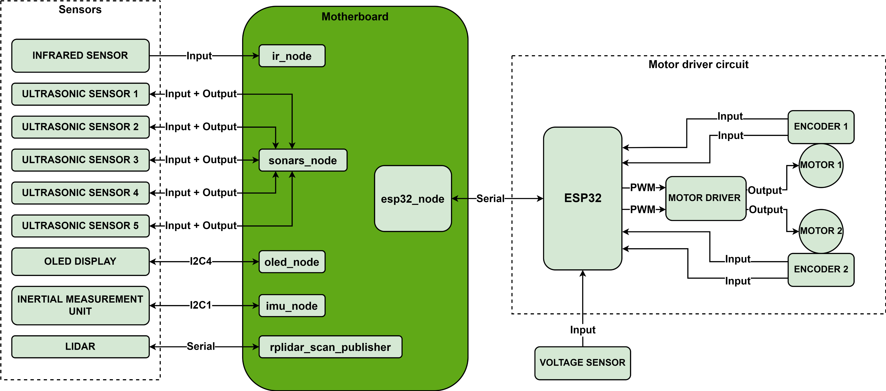
x. FIRMWARE ARCHITECTURE
Fig. 1.1 Firmware architecture

Slide 4
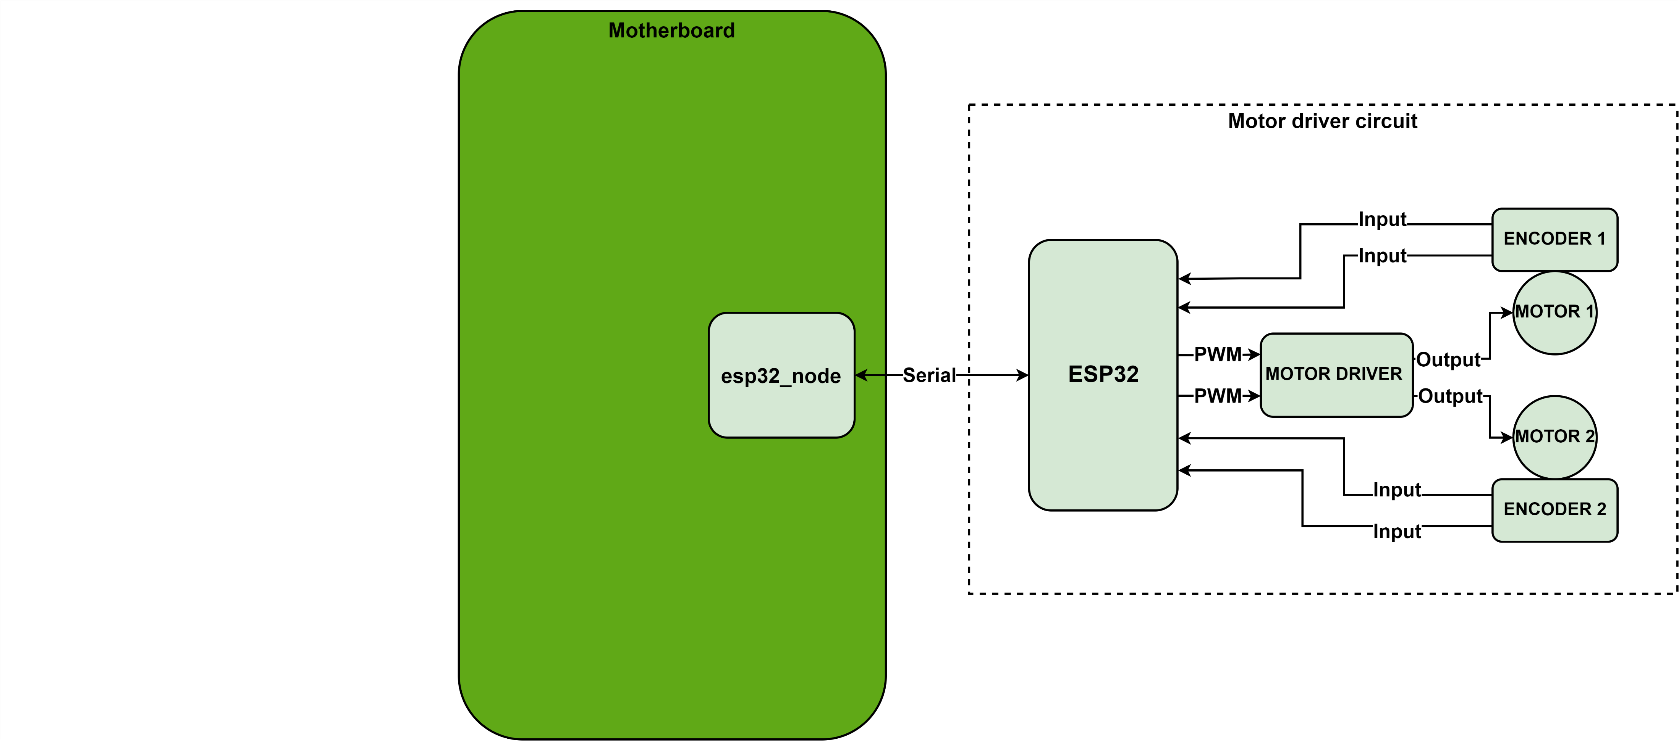
x. MOTOR DRIVER CIRCUIT
Fig. 1.1 Motor driver circuit

Slide 5
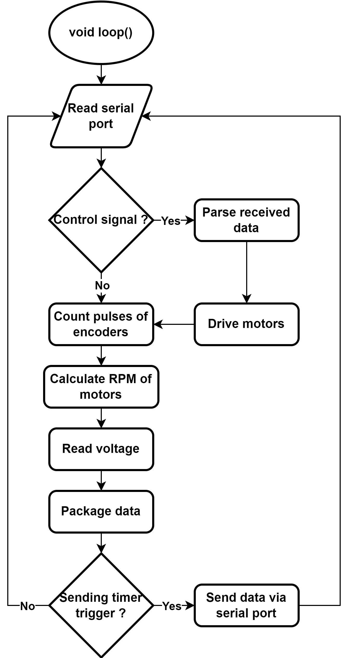
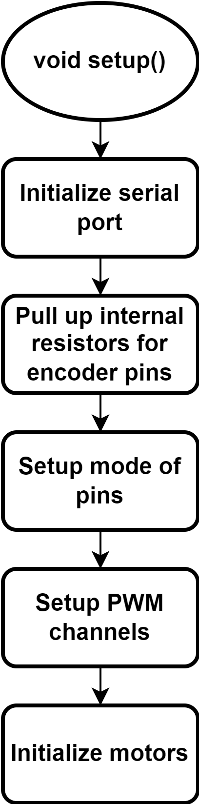
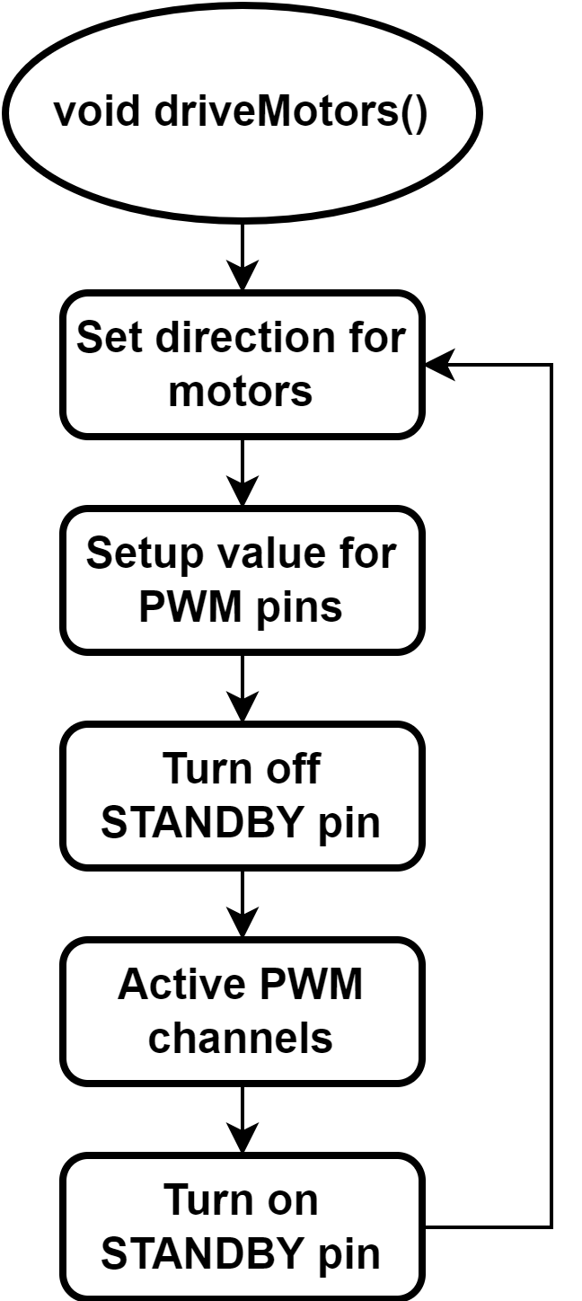
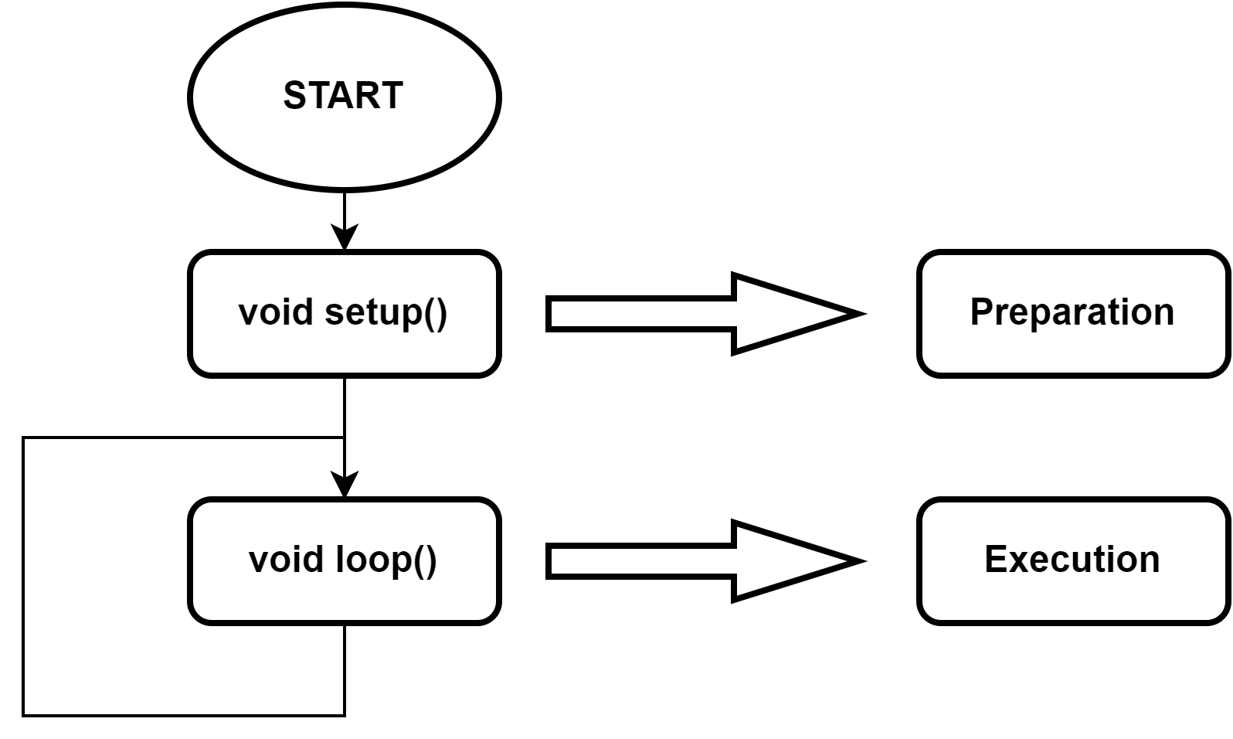
x. MOTOR DRIVER CIRCUIT – ESP32 MCU
Fig. 1.1 Motor driver circuit
Fig. 1.1 Motor driver circuit
Fig. 1.1 Motor driver circuit
Fig. 1.1 Motor driver circuit

Slide 6
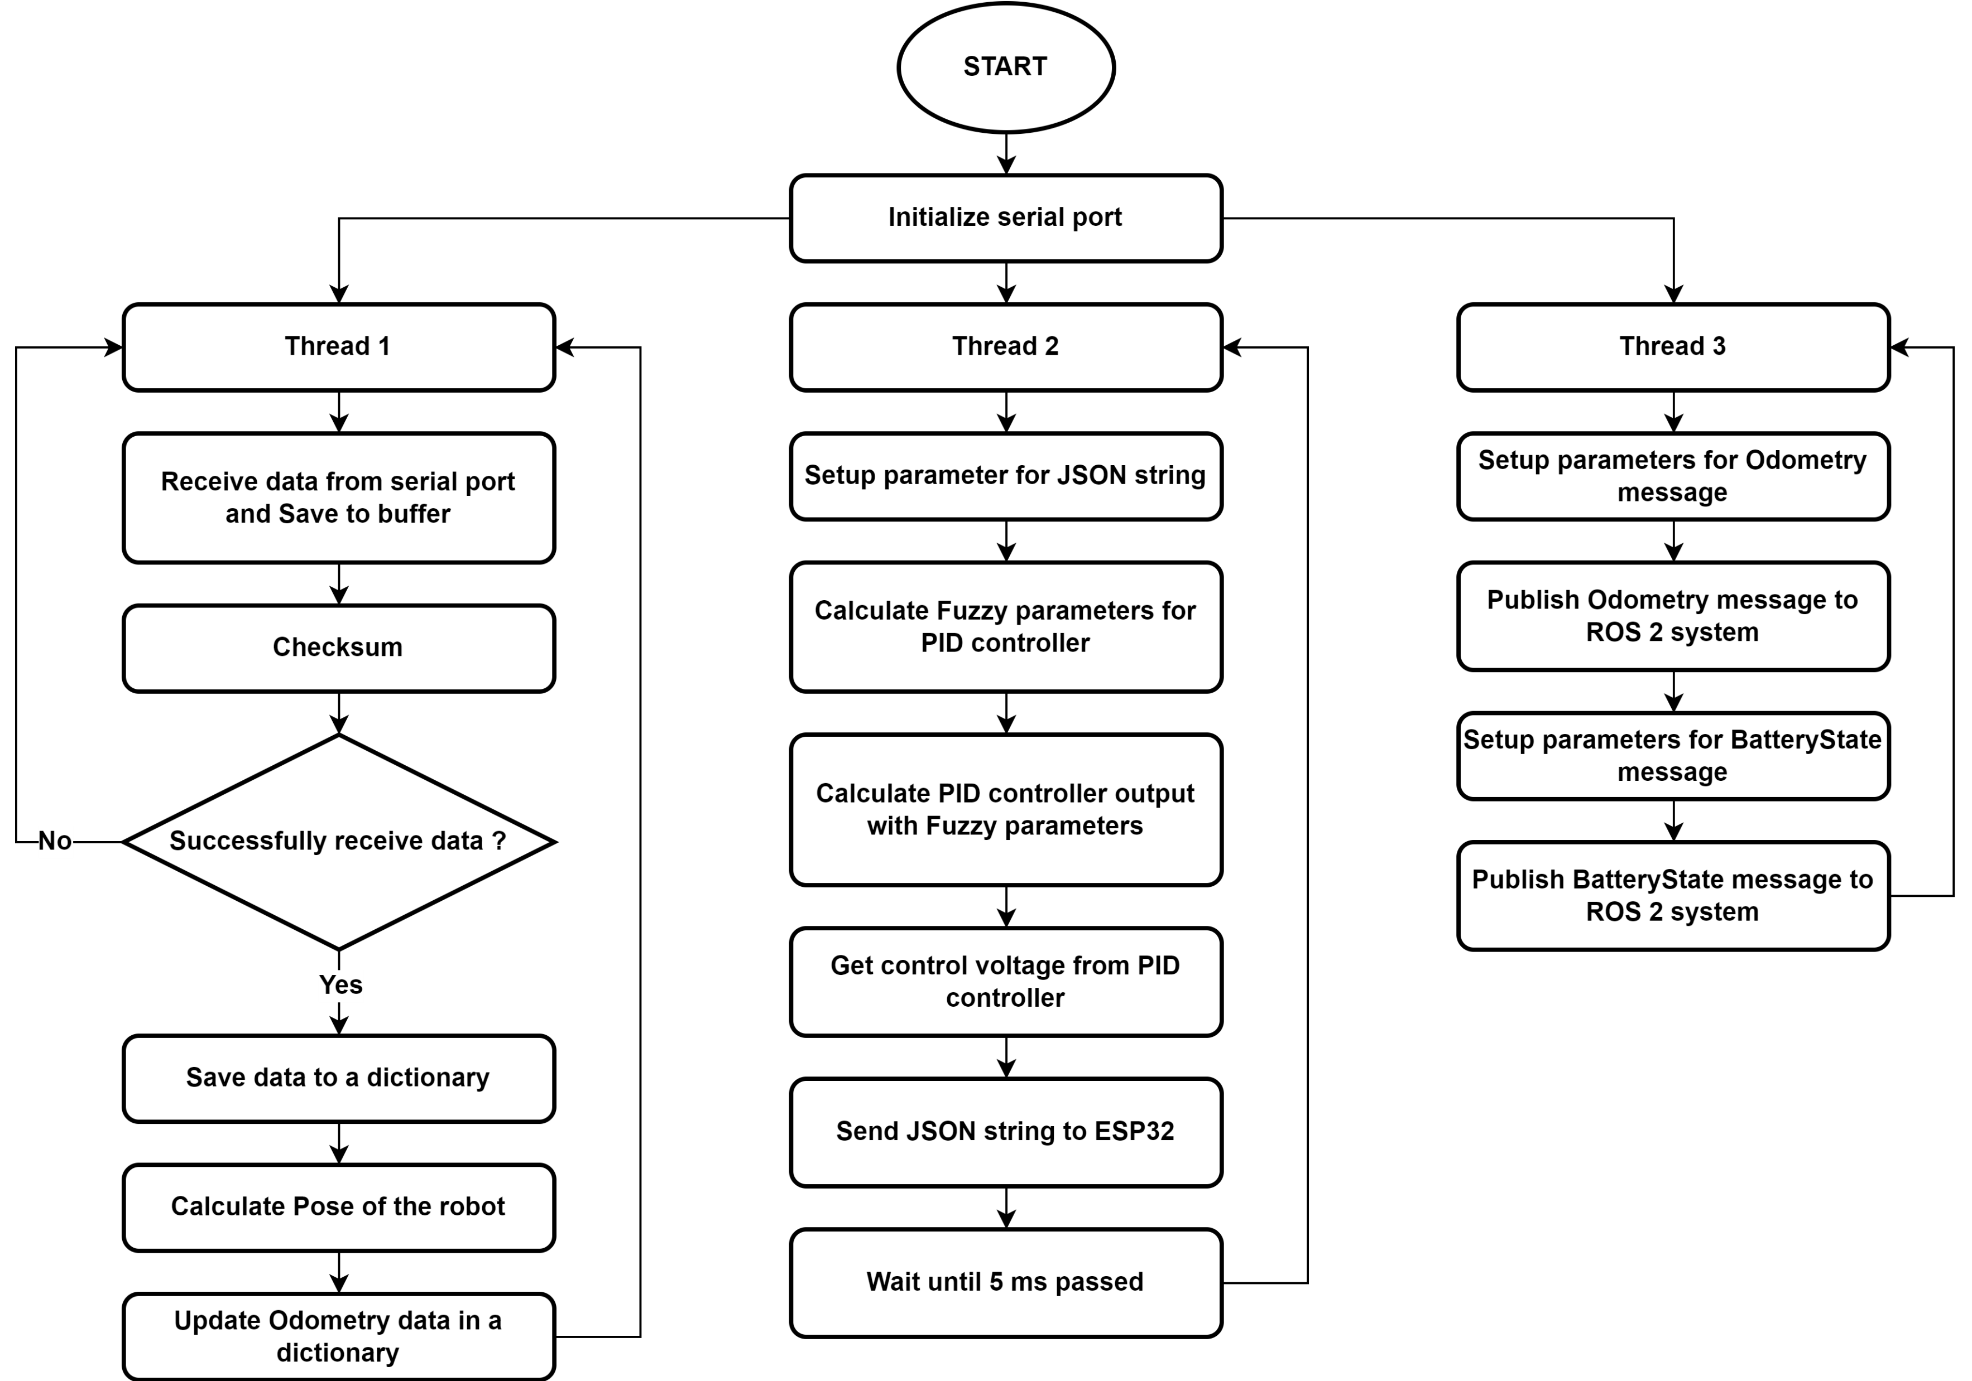
x. MOTOR DRIVER CIRCUIT – RASPBERRY PI 4
Fig. 1.1 Motor driver circuit

Slide 7
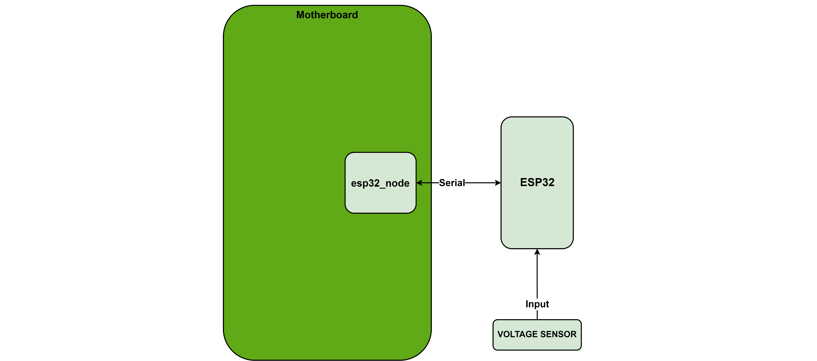
x. VOLTAGE SENSOR
Fig. 1.1 Firmware architecture

Slide 8
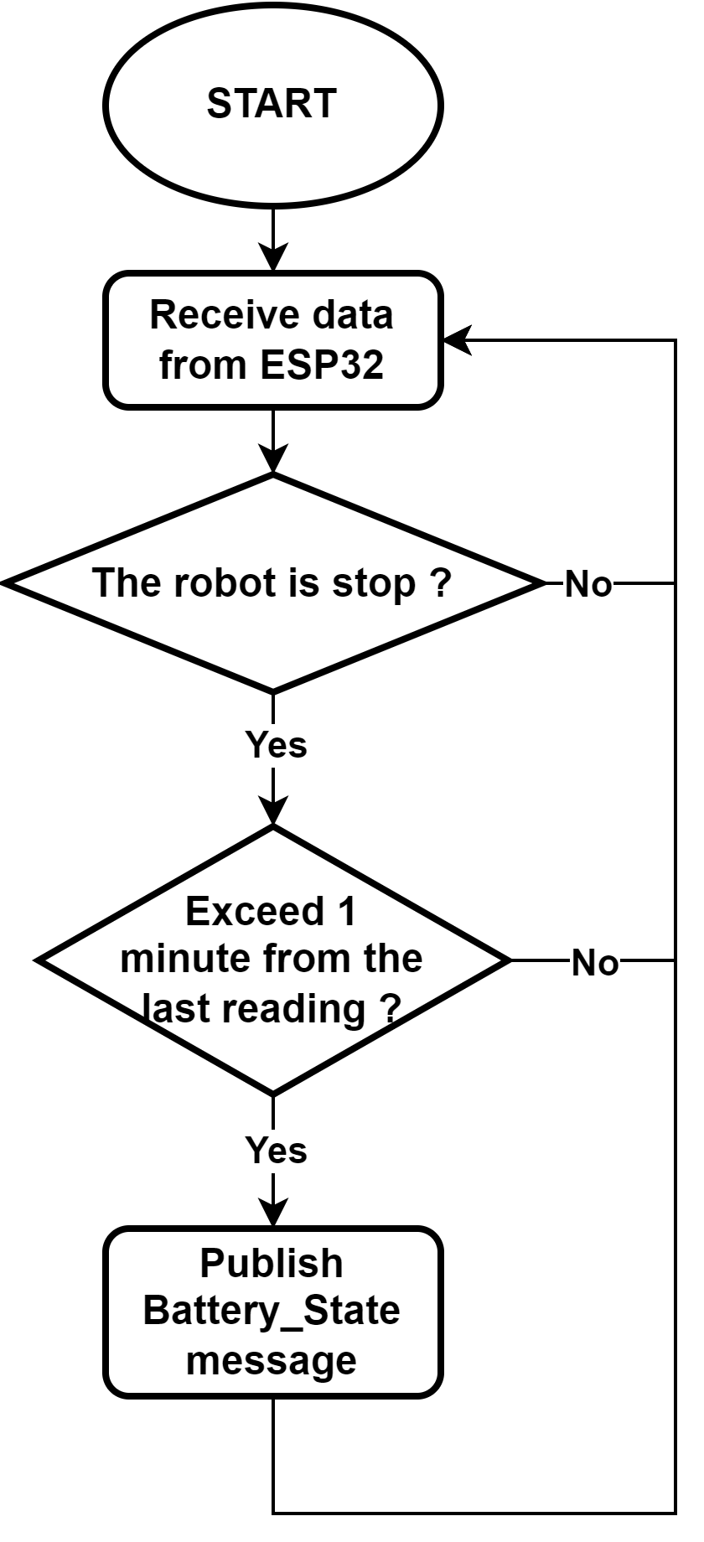
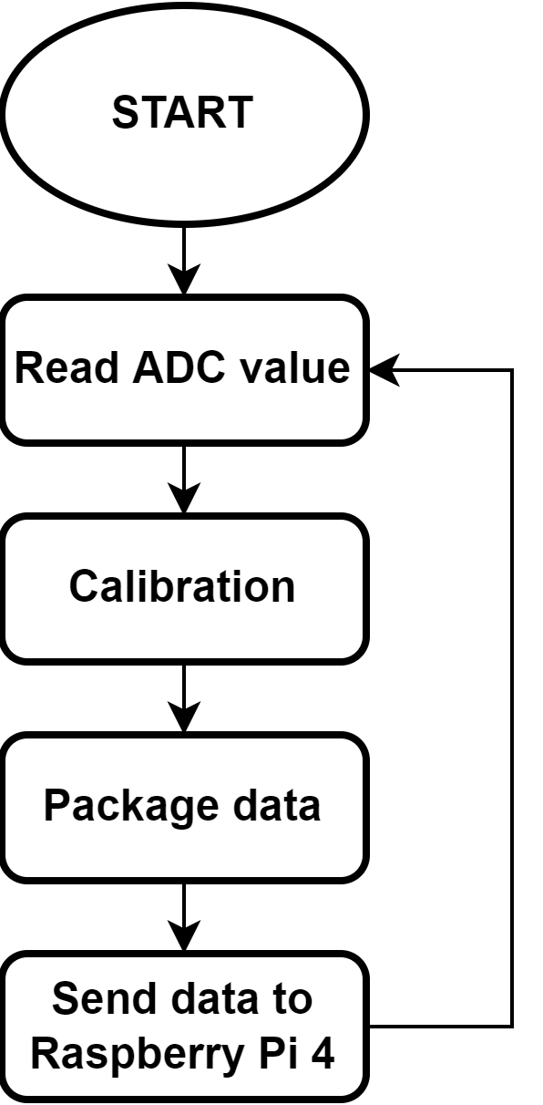

x. VOLTAGE SENSOR
$$V_{real}=V_{ref}−\frac{V_{ref}−V_{read}}{1.668}∙α+ΔV$$
Eq. 1.1 ESP32 microcontroller
Battery voltage | Mainboard voltage | ADC pin voltage | Read voltage | Rate of decrease
12.60 | 12.28 | 3.073 | 3.073 | -
12.58 | 12.27 | 3.072 | 3.071 | 2.000
12.48 | 12.2 | 3.055 | 3.044 | 1.611
12.46 | 12.19 | 3.053 | 3.039 | 1.700
12.43 | 12.13 | 3.039 | 3.022 | 1.500
12.41 | 12.14 | 3.042 | 3.020 | 1.710
12.36 | 12.09 | 3.030 | 3.003 | 1.628
12.31 | 12.04 | 3.016 | 2.979 | 1.649
12.30 | 12.00 | 3.003 | 2.960 | 1.614
12.24 | 11.96 | 2.997 | 2.945 | 1.684
12.19 | 11.91 | 2.983 | 2.924 | 1.656
12.18 | 11.91 | 2.983 | 2.923 | 1.667
12.13 | 11.86 | 2.97 | 2.902 | 1.660
12.12 | 11.82 | 2.961 | 2.890 | 1.634
12.10 | 11.80 | 2.956 | 2.879 | 1.658
12.08 | 11.78 | 2.951 | 2.872 | 1.648
12.05 | 11.75 | 2.944 | 2.858 | 1.667
Fig. 1.1 ESP32 microcontroller
Fig. 1.1 ESP32 microcontroller
Fig. 1.1 ESP32 microcontroller

Slide 9

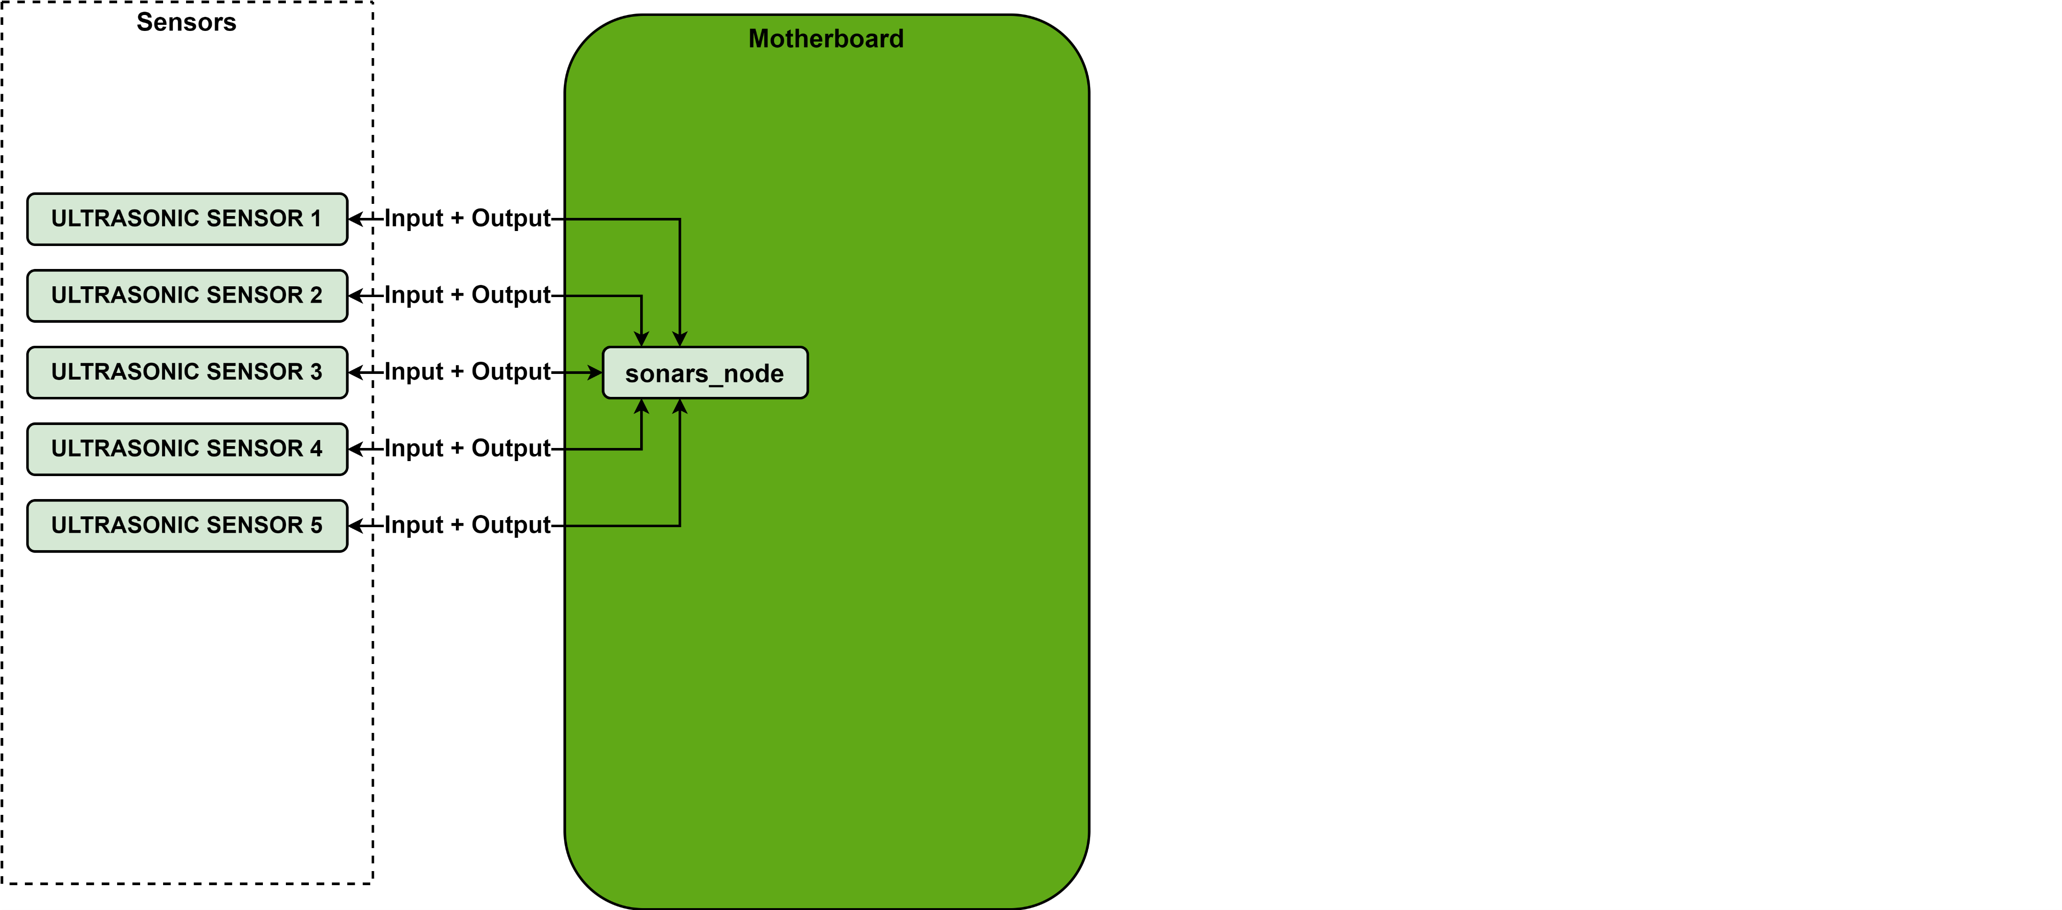
x. ULTRASONIC SENSORS
Fig. 1.1 Firmware architecture

Slide 10
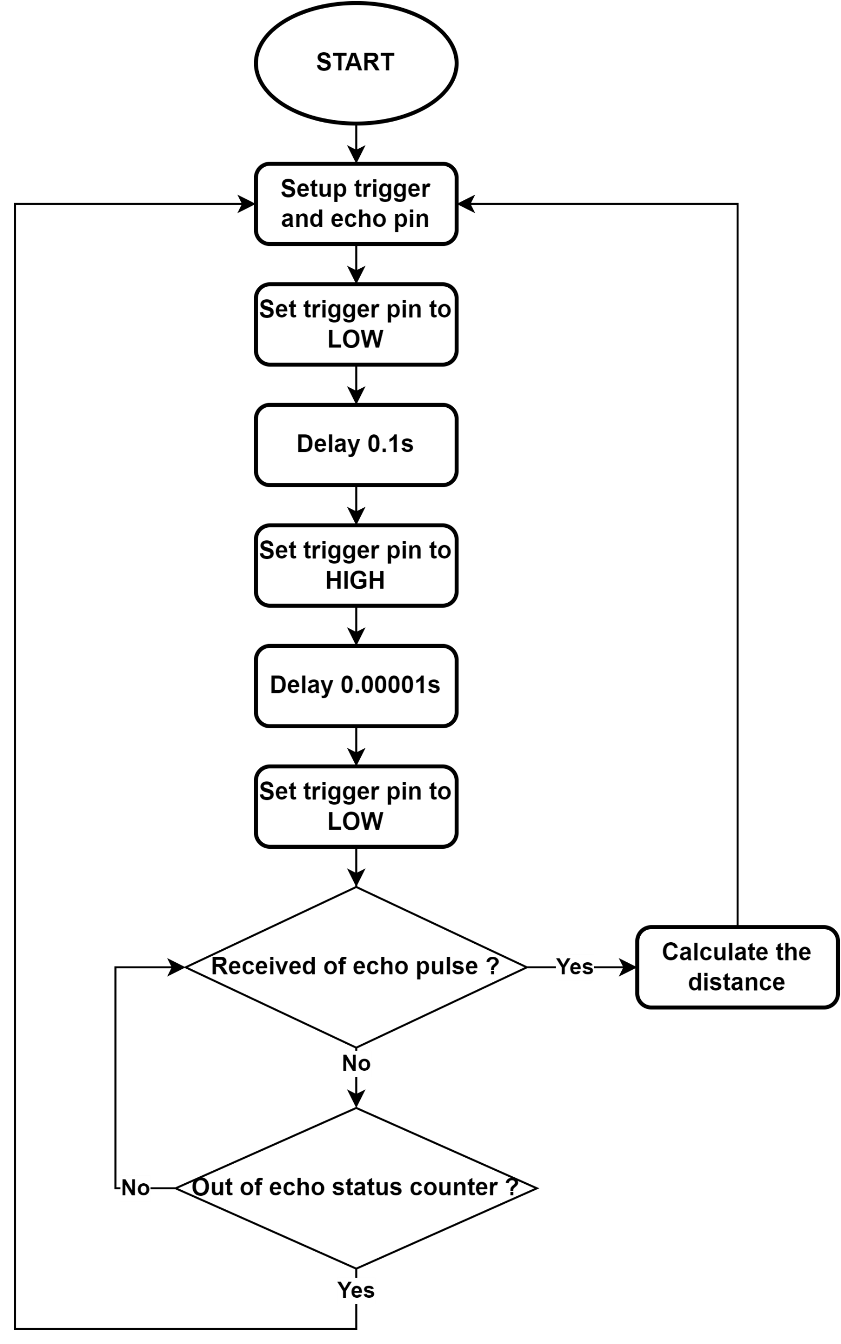
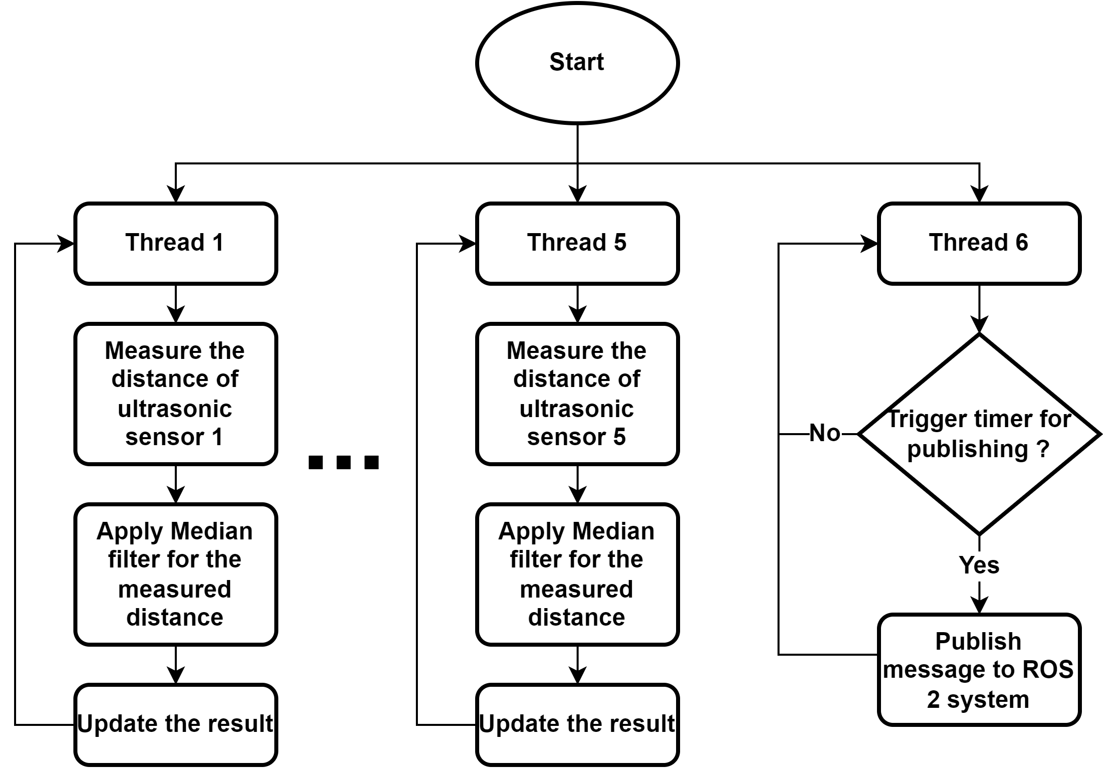
x. ULTRASONIC SENSORS
Fig. 1.1 Firmware architecture
Fig. 1.1 Firmware architecture

Slide 11
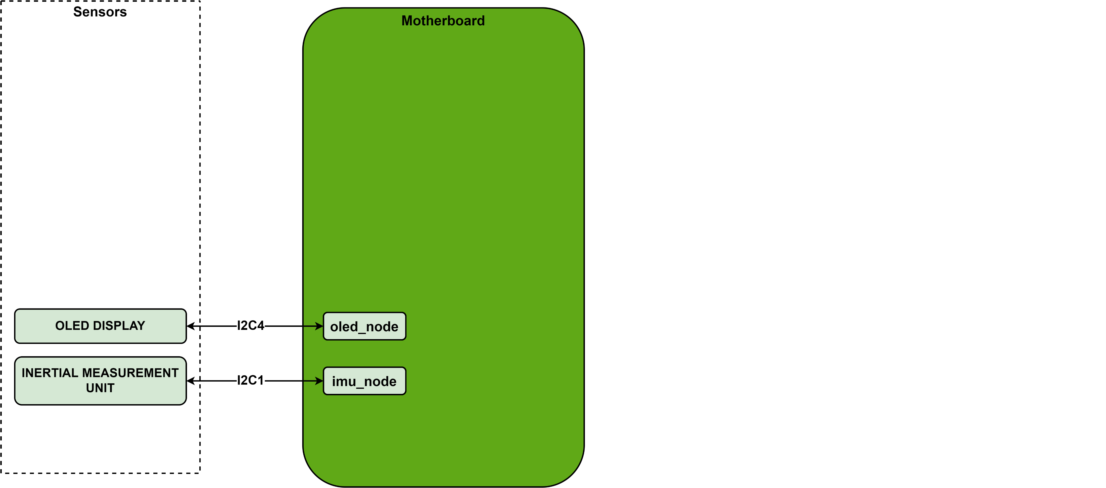
x. I2C BUSES – PROBLEM AND SOLUTION
Fig. 1.1 Firmware architecture

Slide 12
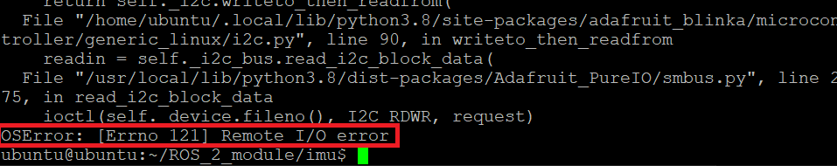
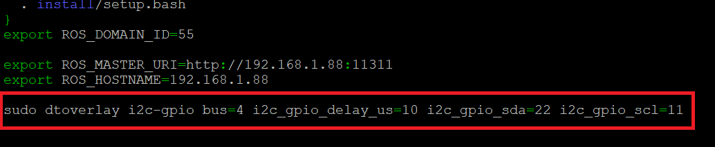
x. I2C BUSES – PROBLEM AND SOLUTION
Fig. 1.1 Firmware architecture
Fig. 1.1 Firmware architecture

Slide 13
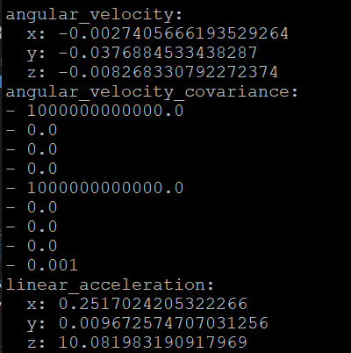
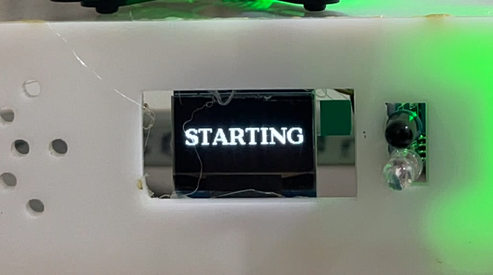
x. I2C BUSES FIXED RESULT
Fig. 1.1 Firmware architecture
Fig. 1.1 Firmware architecture

Slide 14
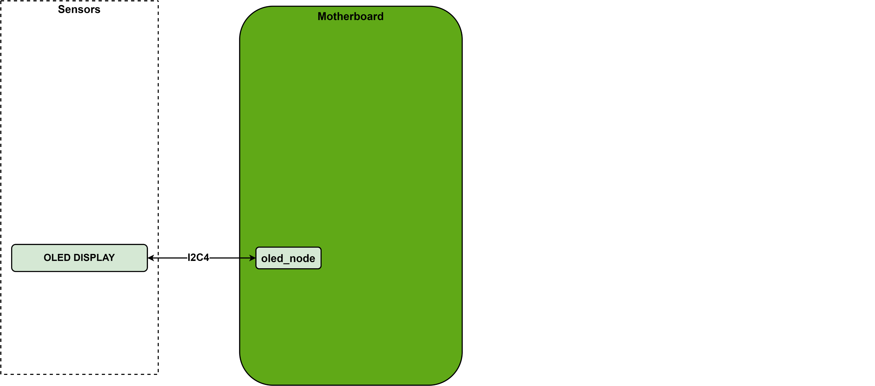
x. OLED DISLPAY
Fig. 1.1 Firmware architecture

Slide 15
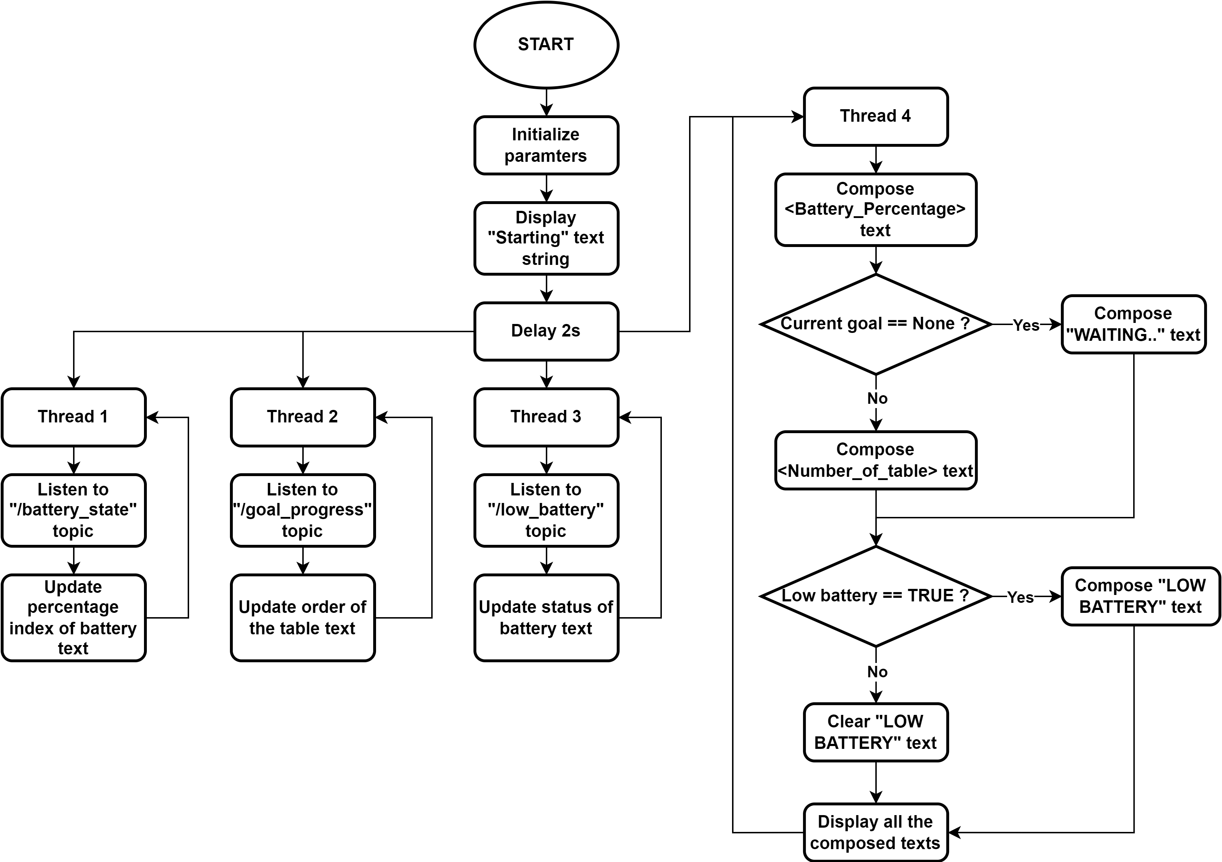
x. OLED DISLPAY
Fig. 1.1 Firmware architecture

Slide 16
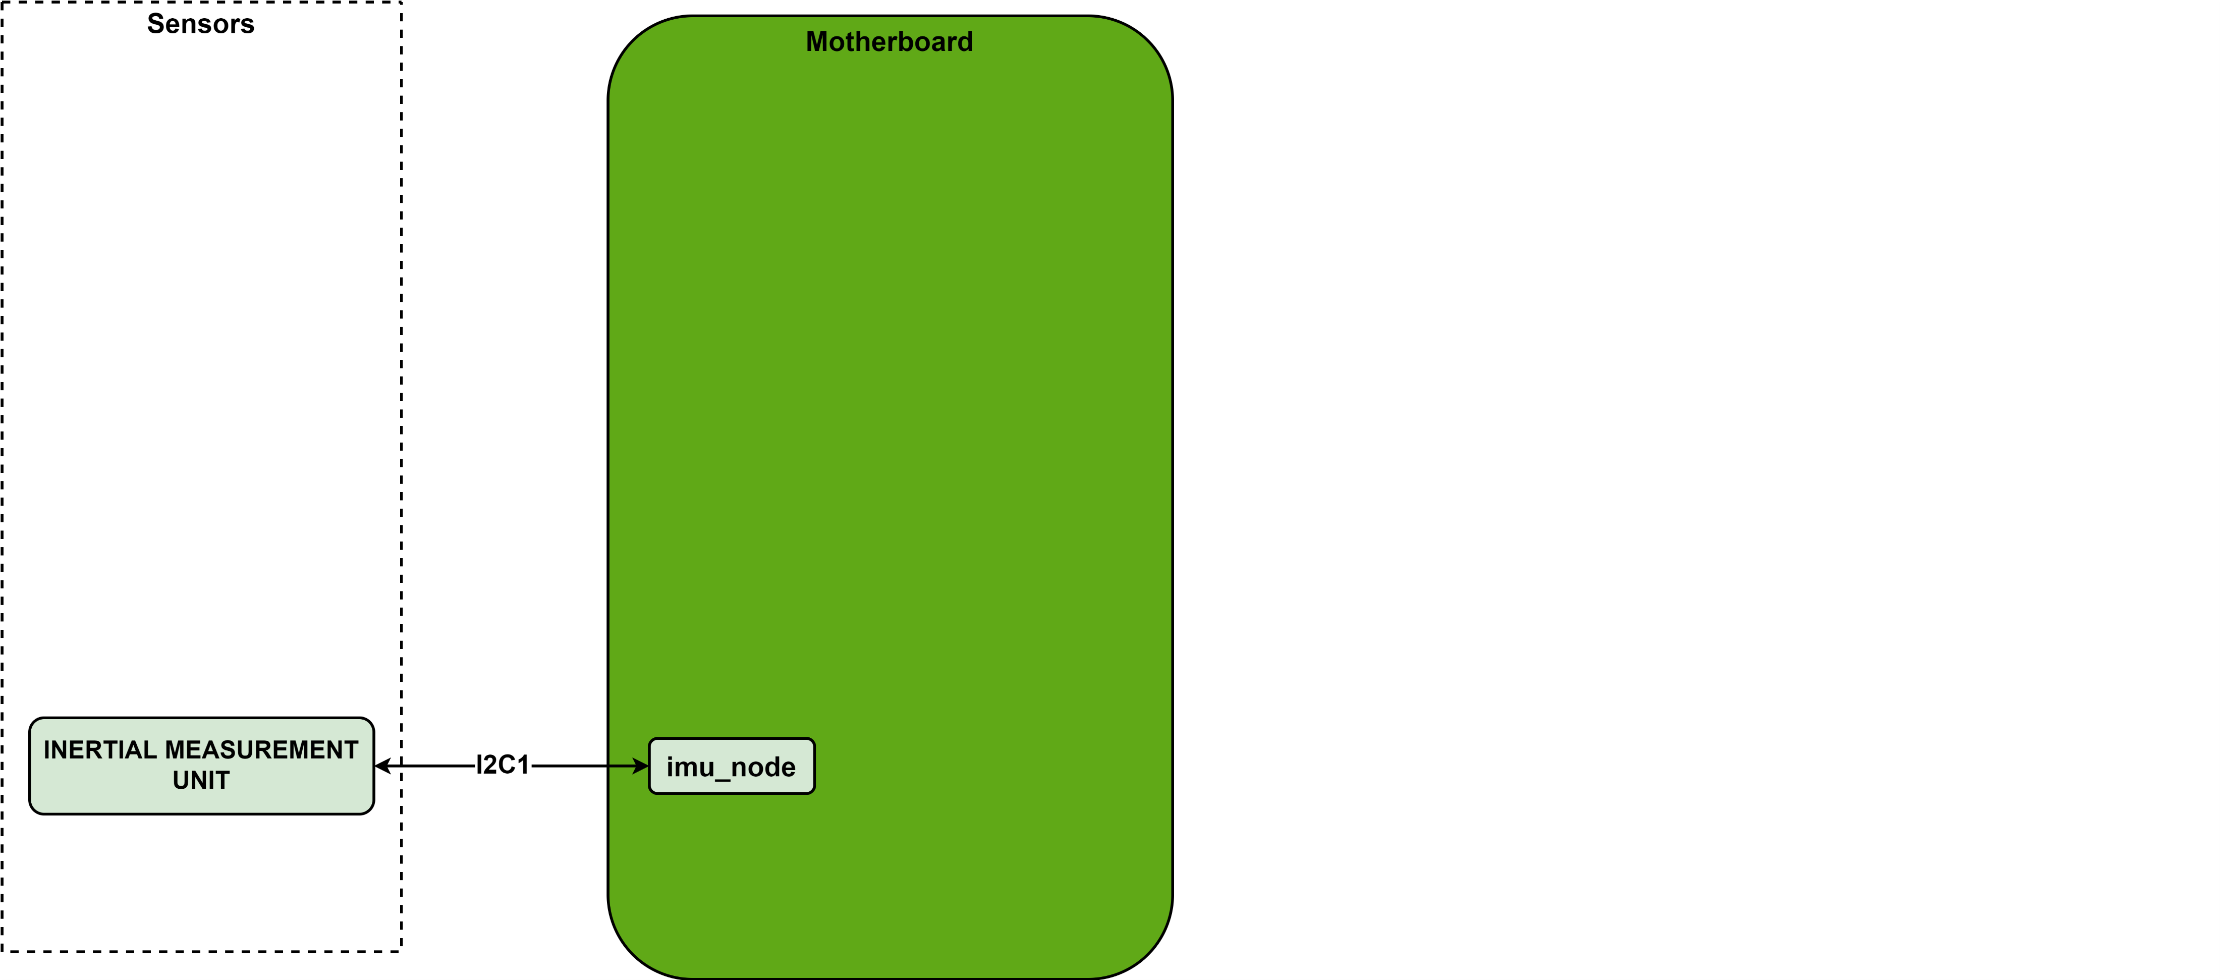
x. INERTIAL MEASUREMENT UNIT SENSOR
Fig. 1.1 Firmware architecture

Slide 17
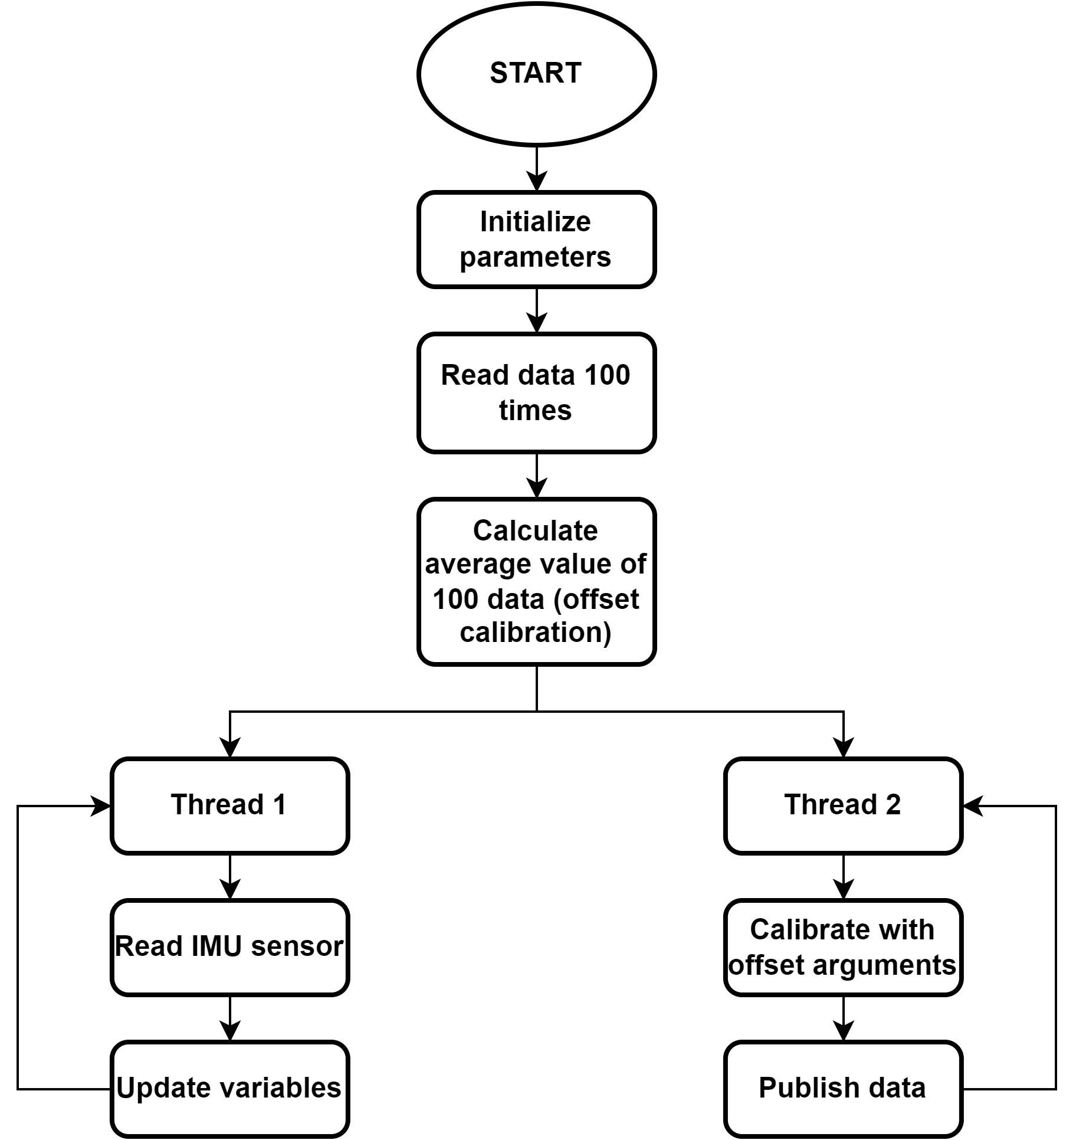
x. INERTIAL MEASUREMENT UNIT SENSOR
Fig. 1.1 Firmware architecture
Fig. 1.1 Firmware architecture

Slide 18
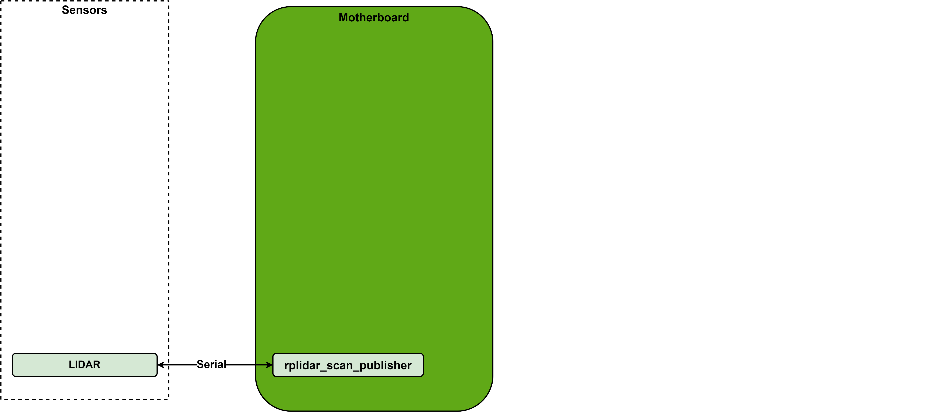
x. LIDAR SENSOR
Fig. 1.1 Firmware architecture

Slide 19
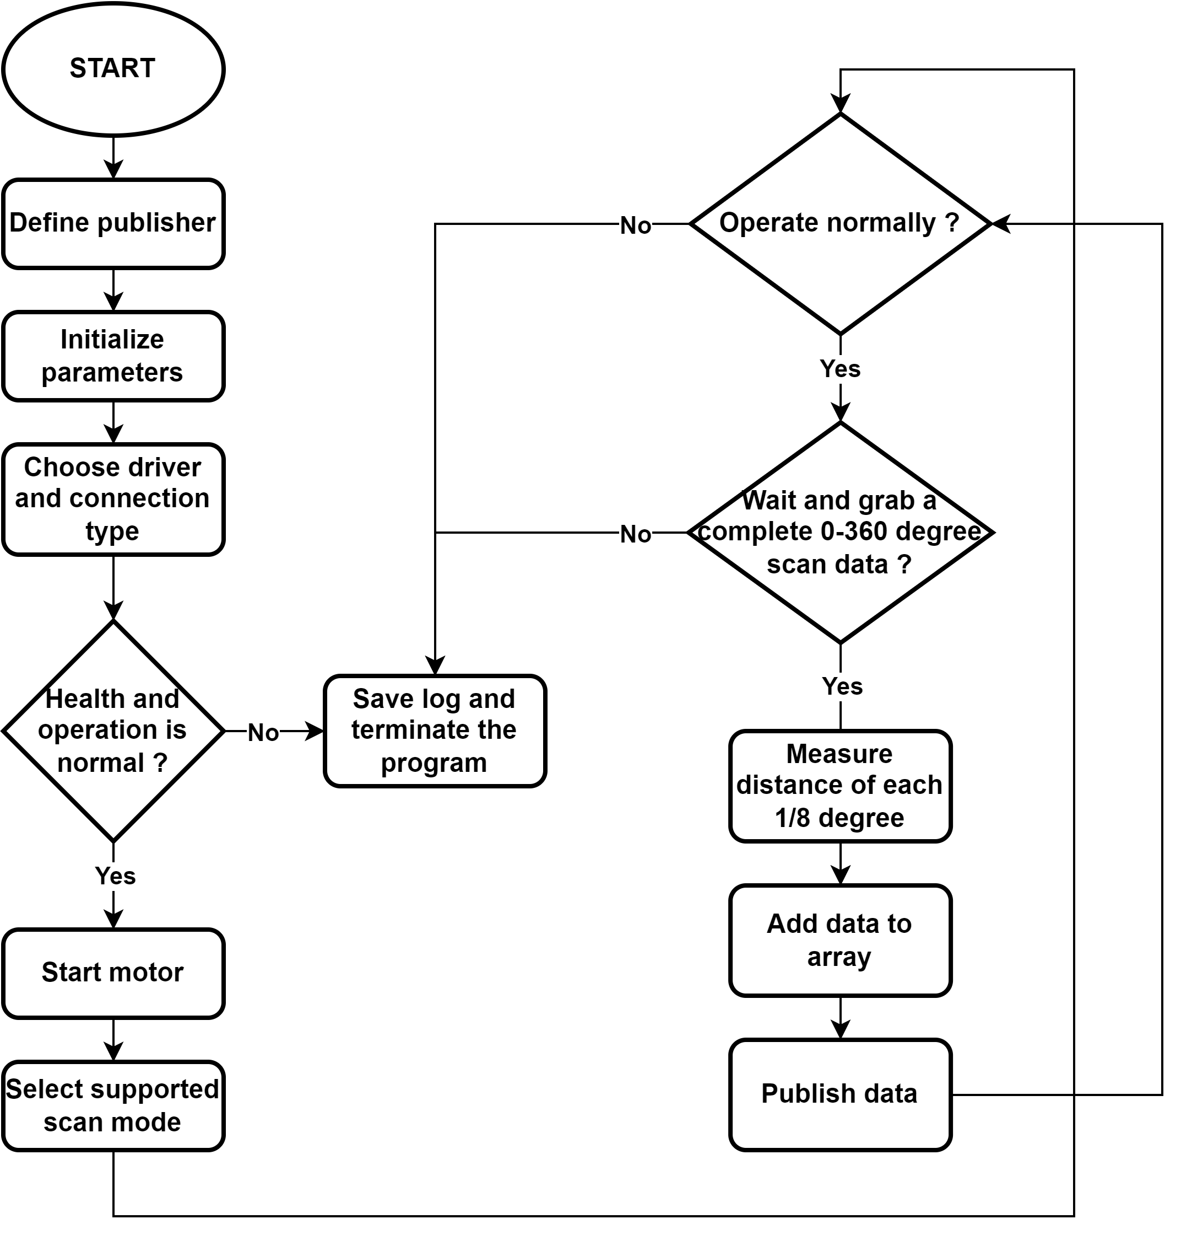
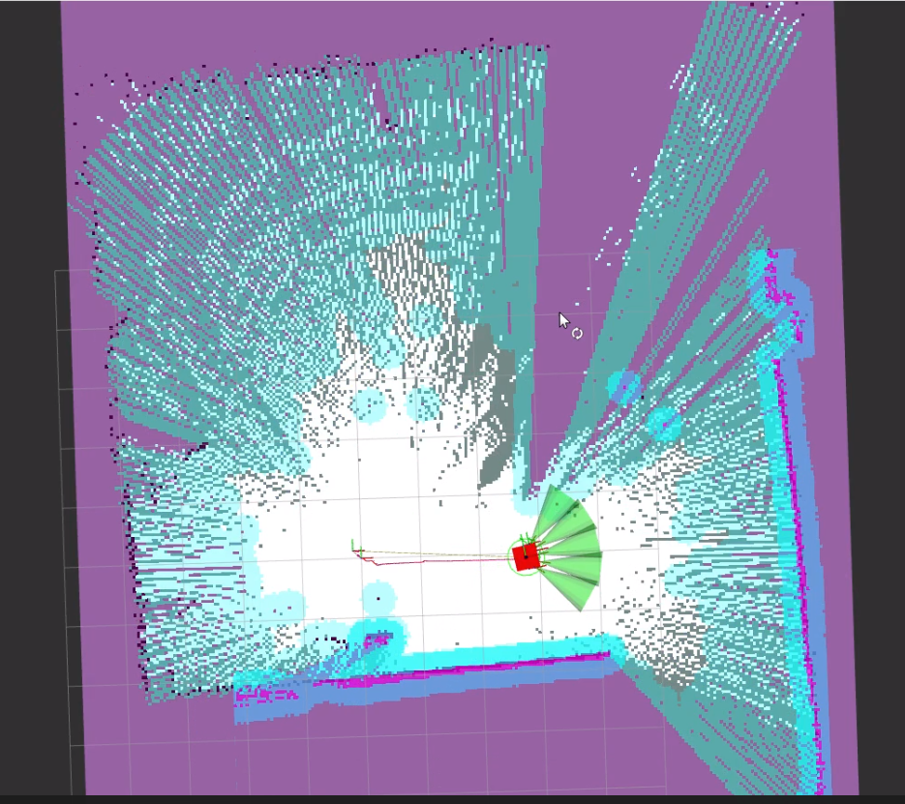
x. LIDAR SENSOR
Fig. x.x The Obtained Environment Map from RPLIDAR A1 Scanning
Fig. 1.1 Firmware architecture

Slide 20
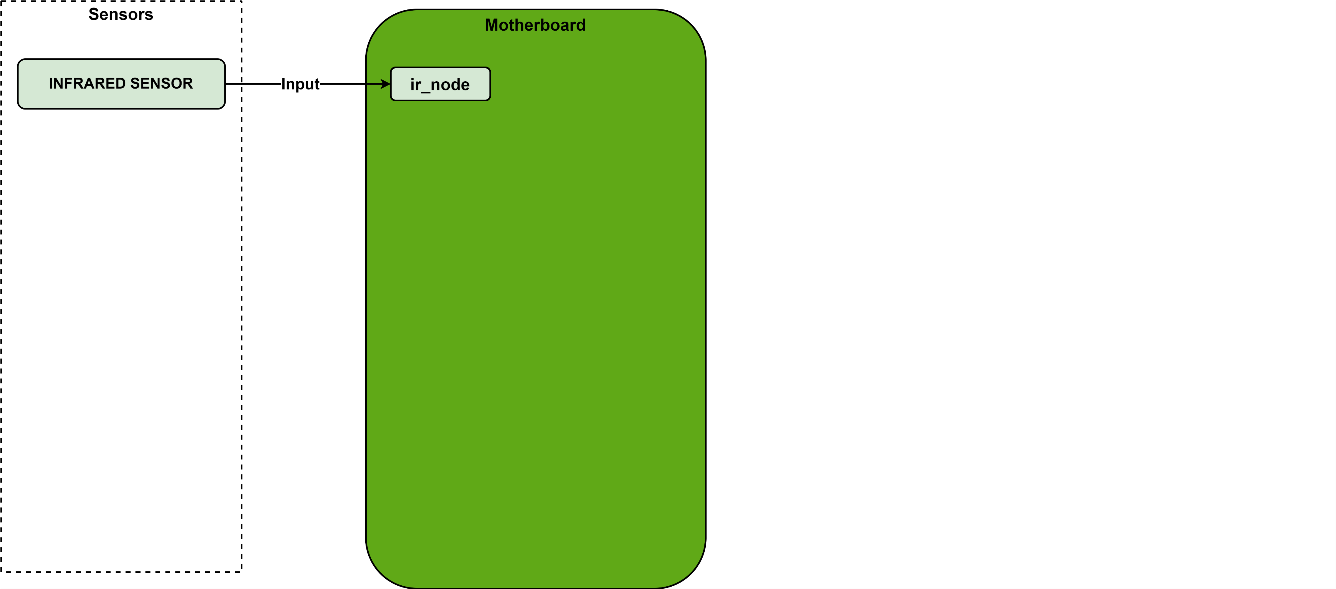
x. INFRARED SENSOR
Fig. 1.1 Firmware architecture

Slide 21
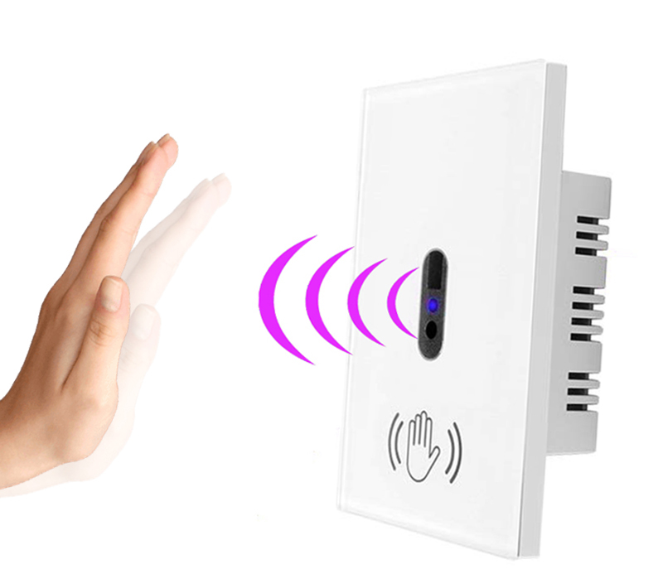
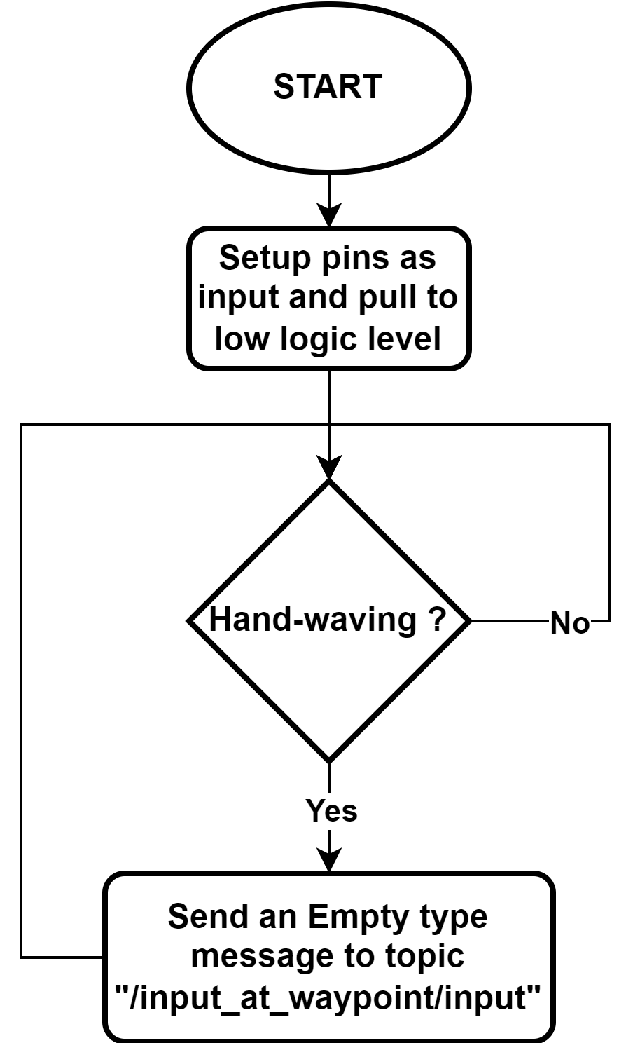
x. INFRARED SENSOR
Fig. 1.1 Firmware architecture
Fig. 1.1 Firmware architecture

Slide 22
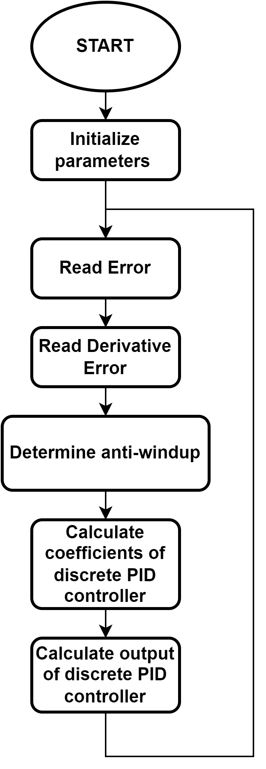
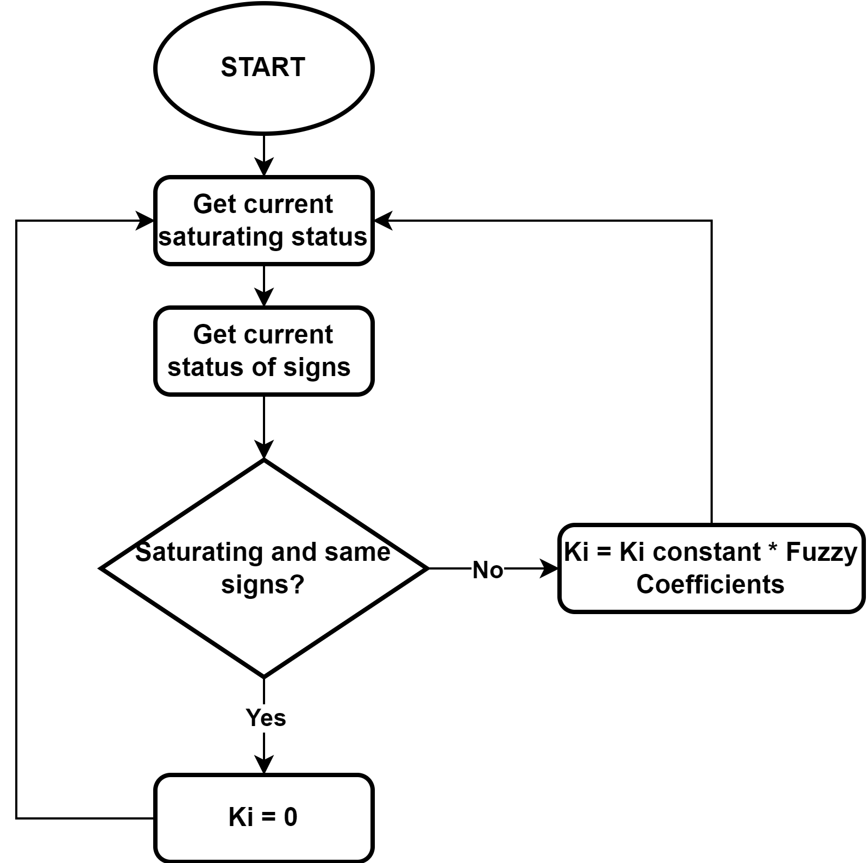
x. PID CONTROLLER FLOWCHART
Fig. 1.1 Firmware architecture

Slide 23
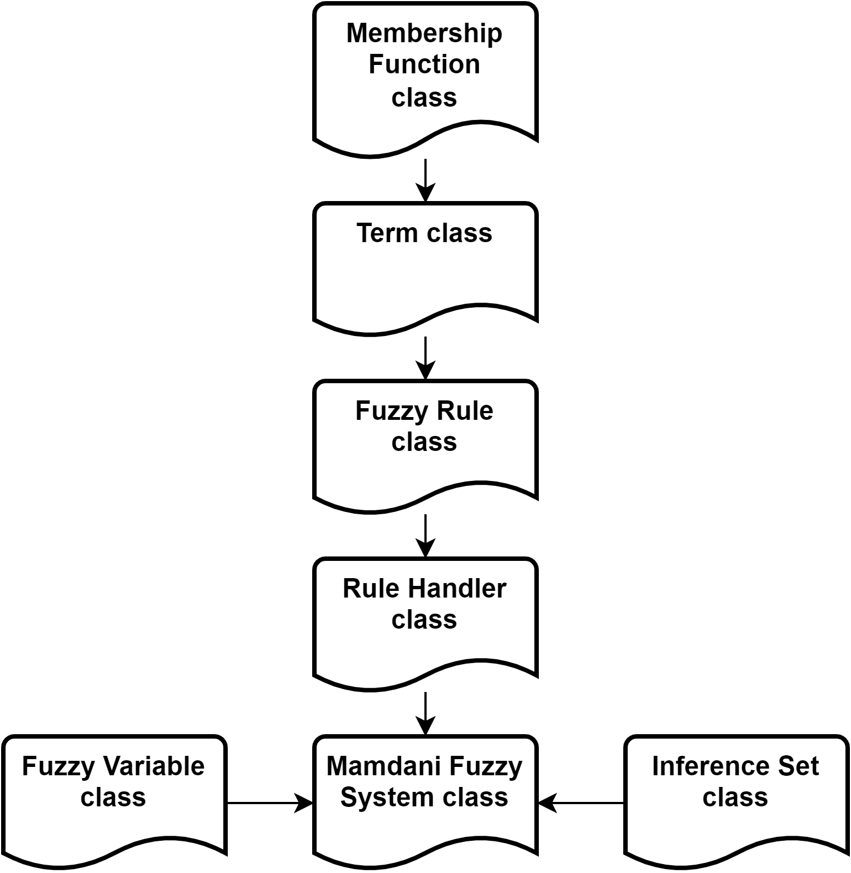
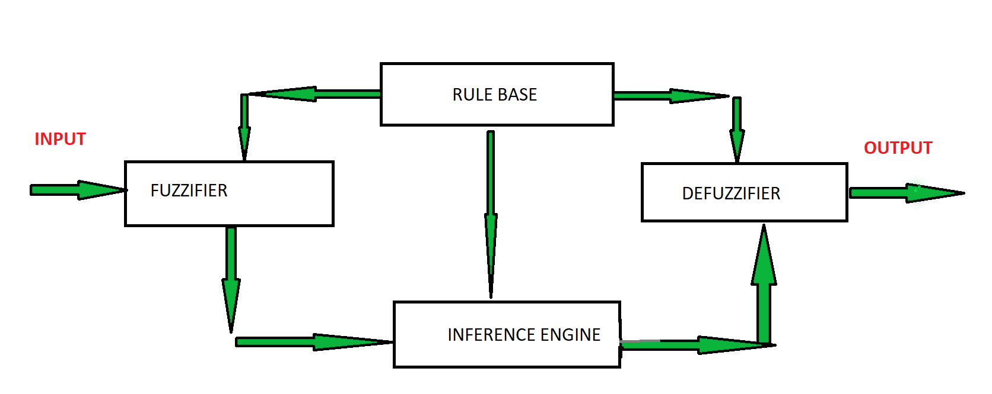
x. C++ FUZZY LOGIC LIBRARY
Fig. 1.1 Firmware architecture
Fig. 1.1 Firmware architecture

Slide 24
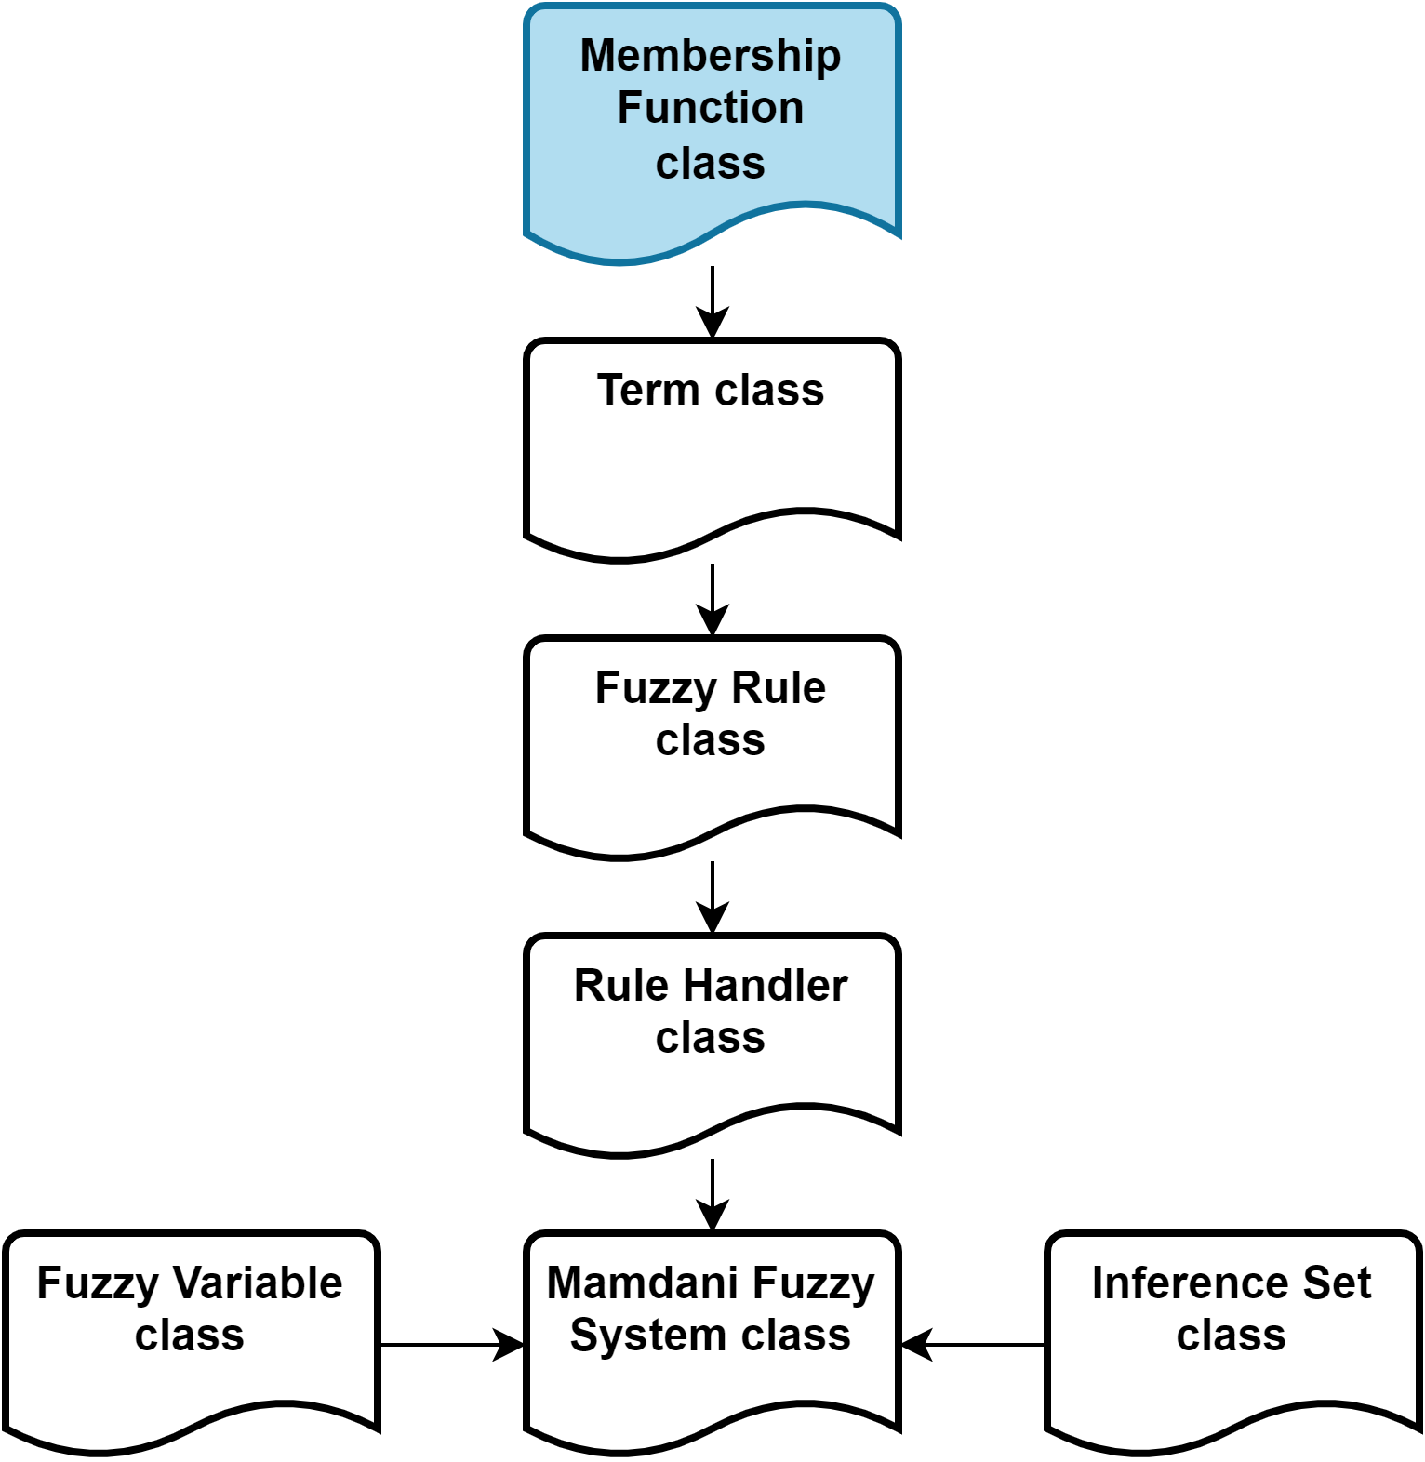
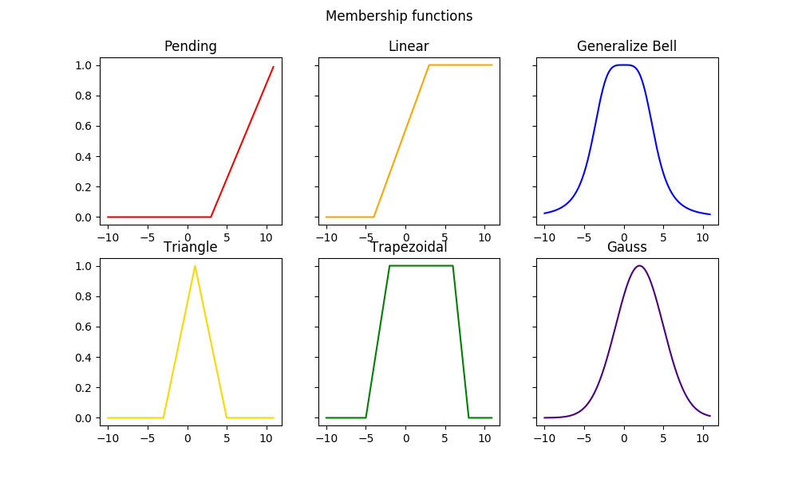
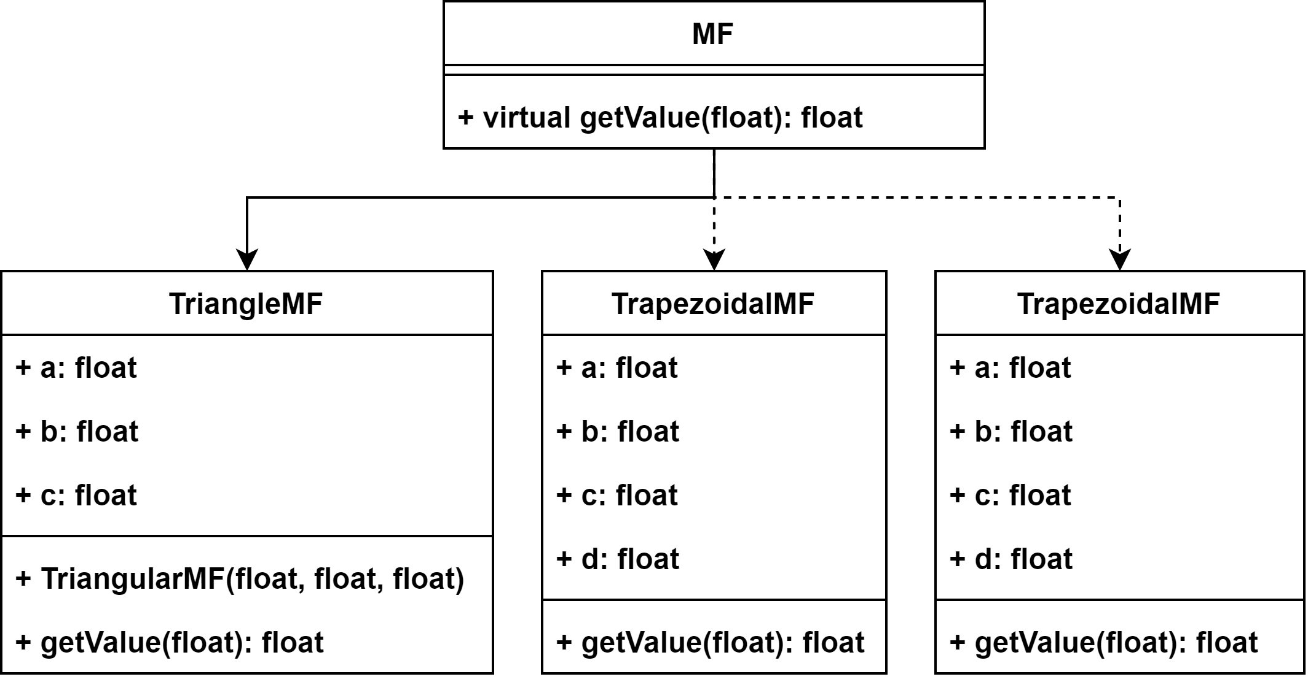
x. C++ FUZZY LOGIC LIBRARY
Fig. 1.x Firmware architecture
Fig. 1.1 Firmware architecture

Slide 25
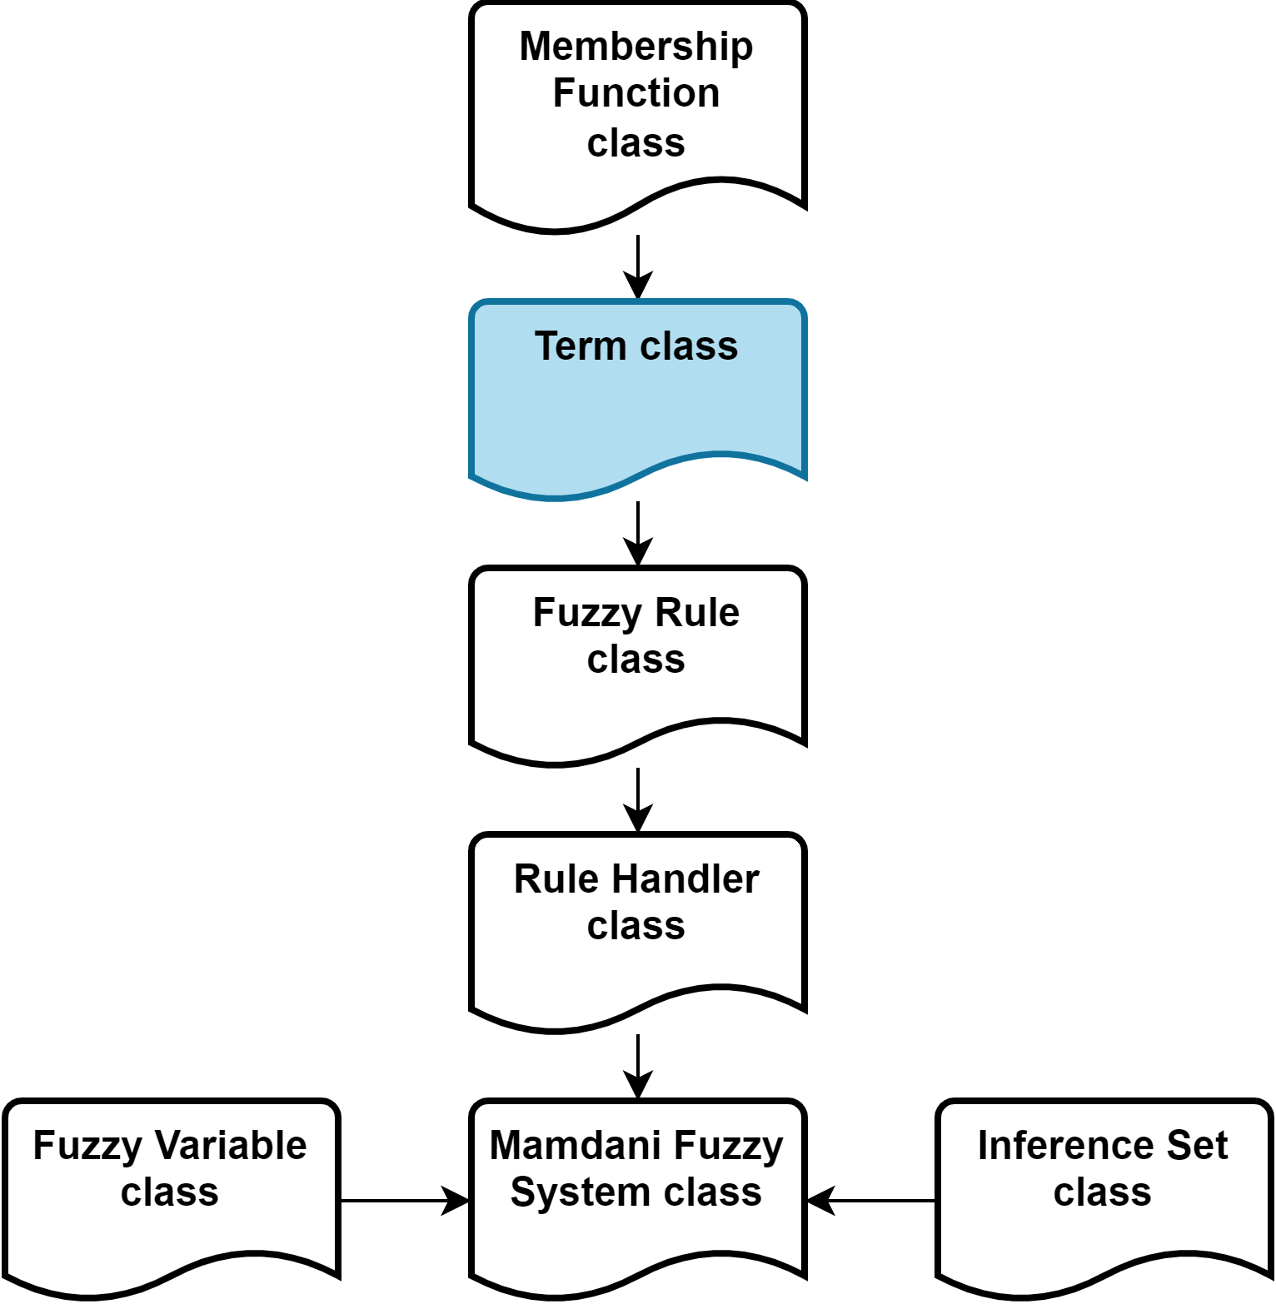
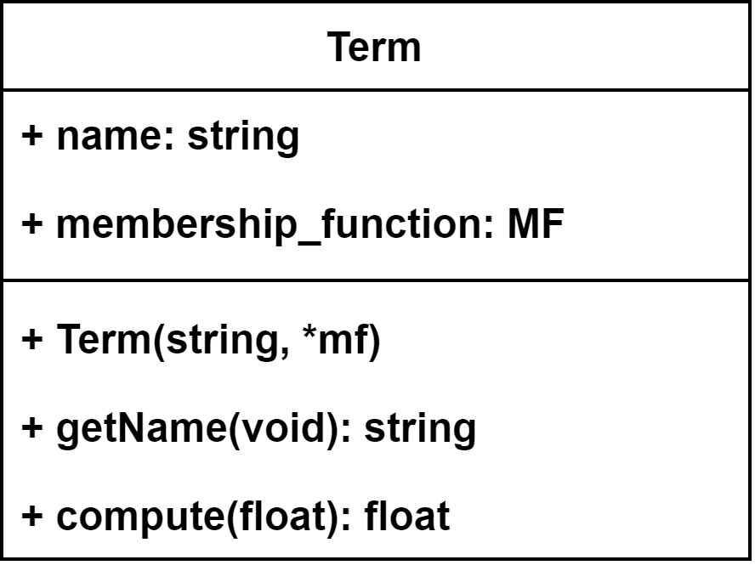
x. C++ FUZZY LOGIC LIBRARY
Fig. 1.1 Firmware architecture

Slide 26
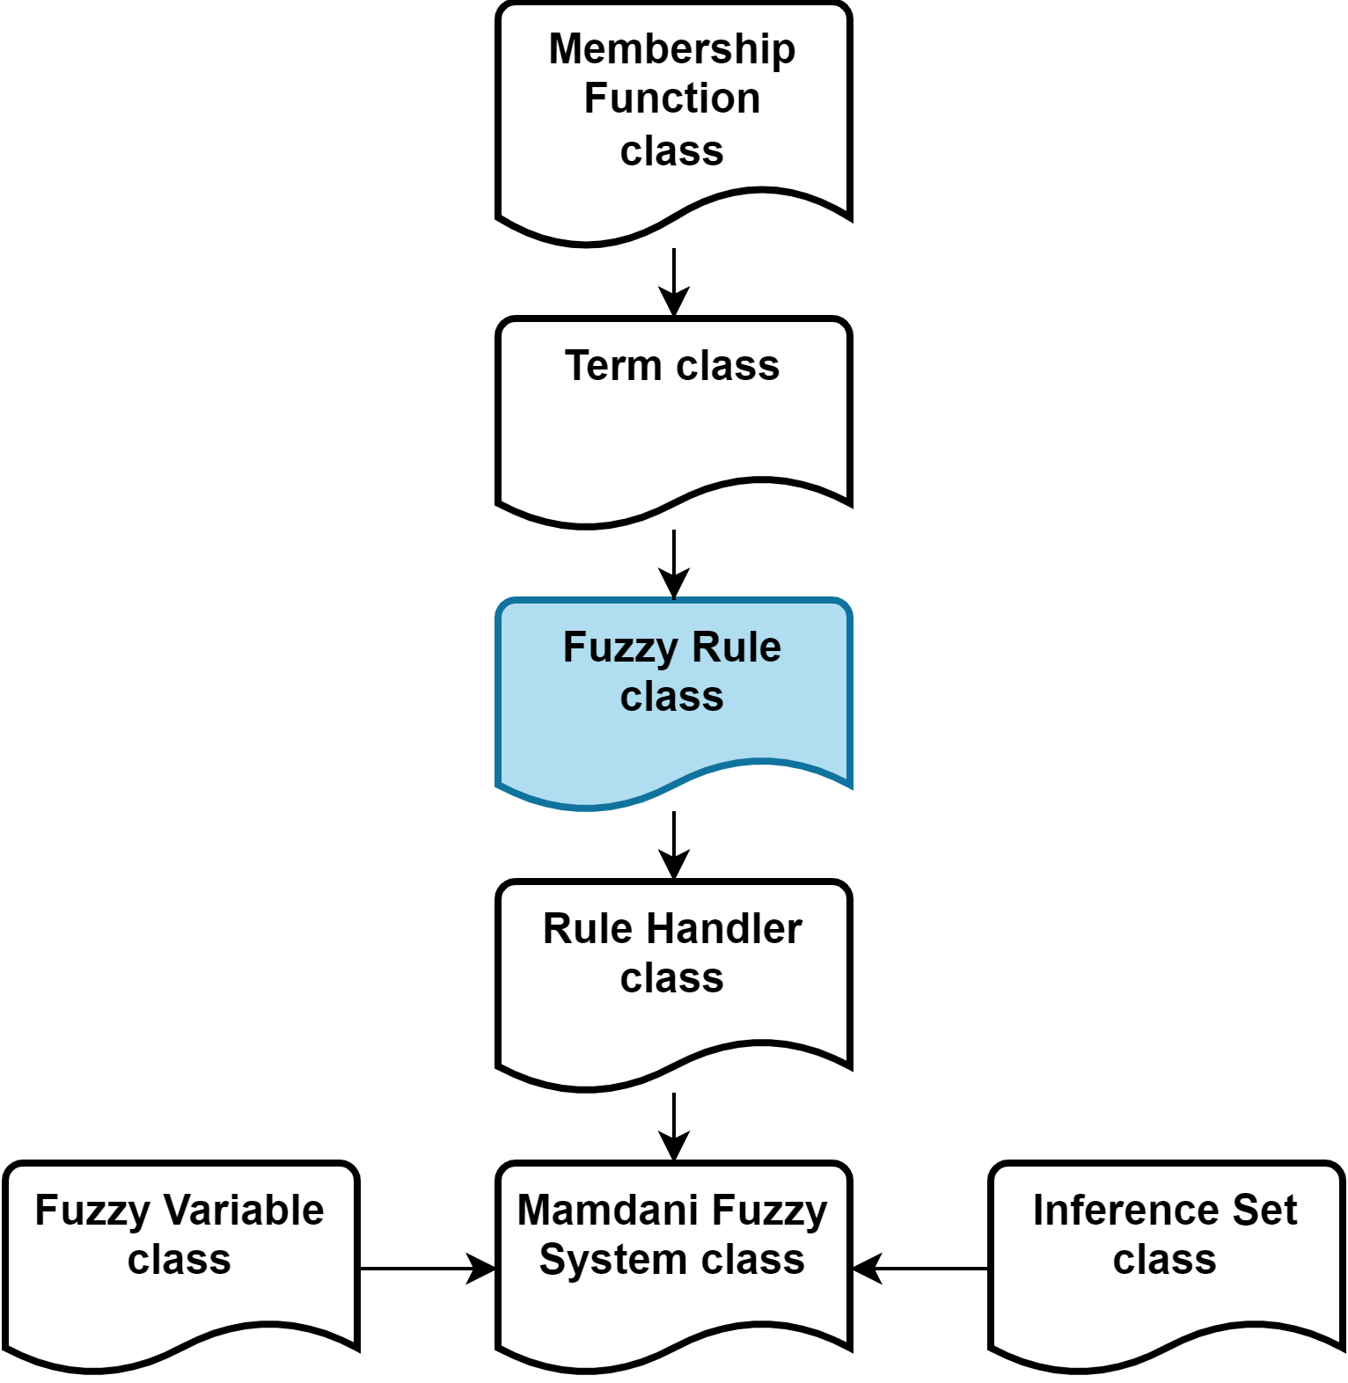
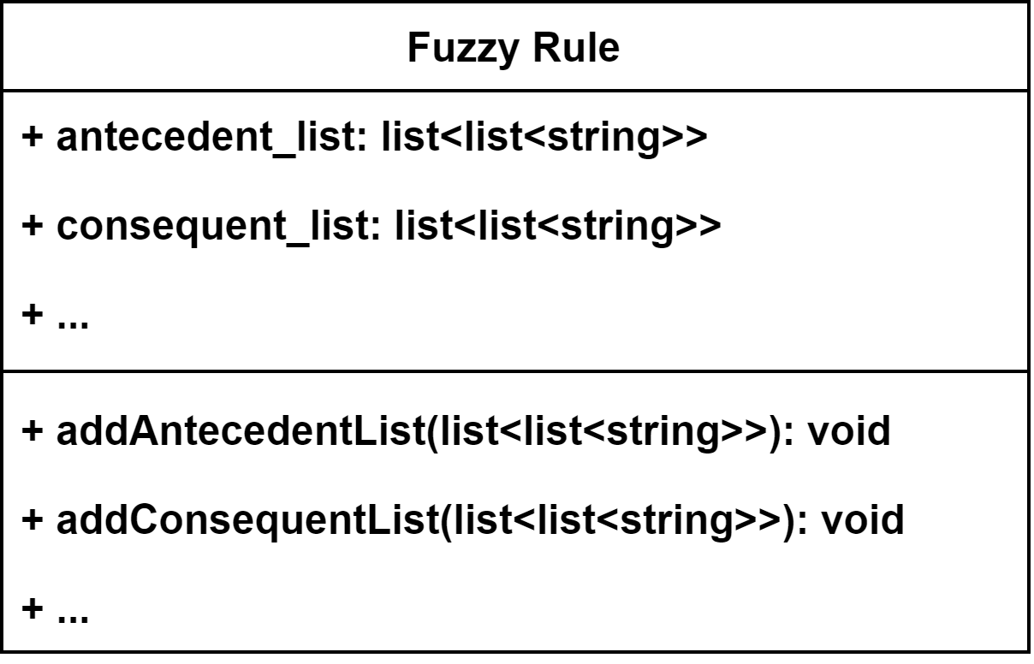
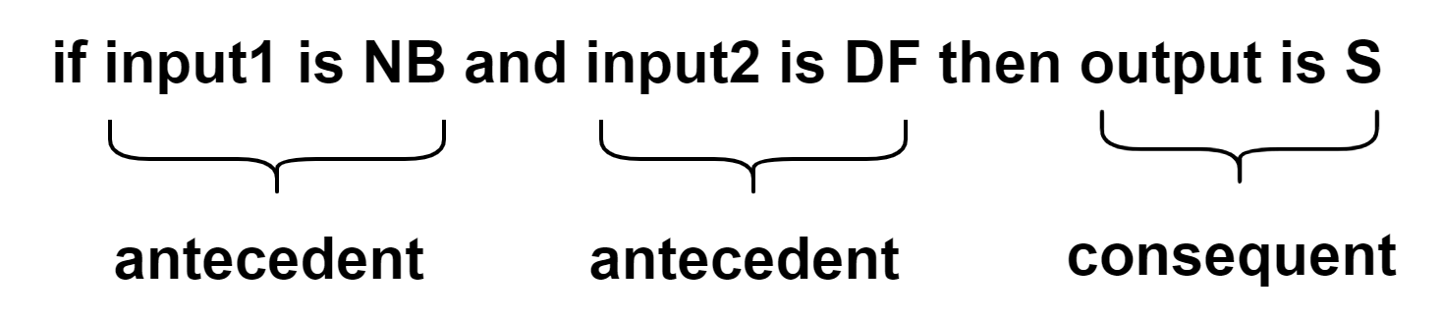
x. C++ FUZZY LOGIC LIBRARY
Fig. 1.1 Firmware architecture
Fig. 1.1 Firmware architecture

Slide 27
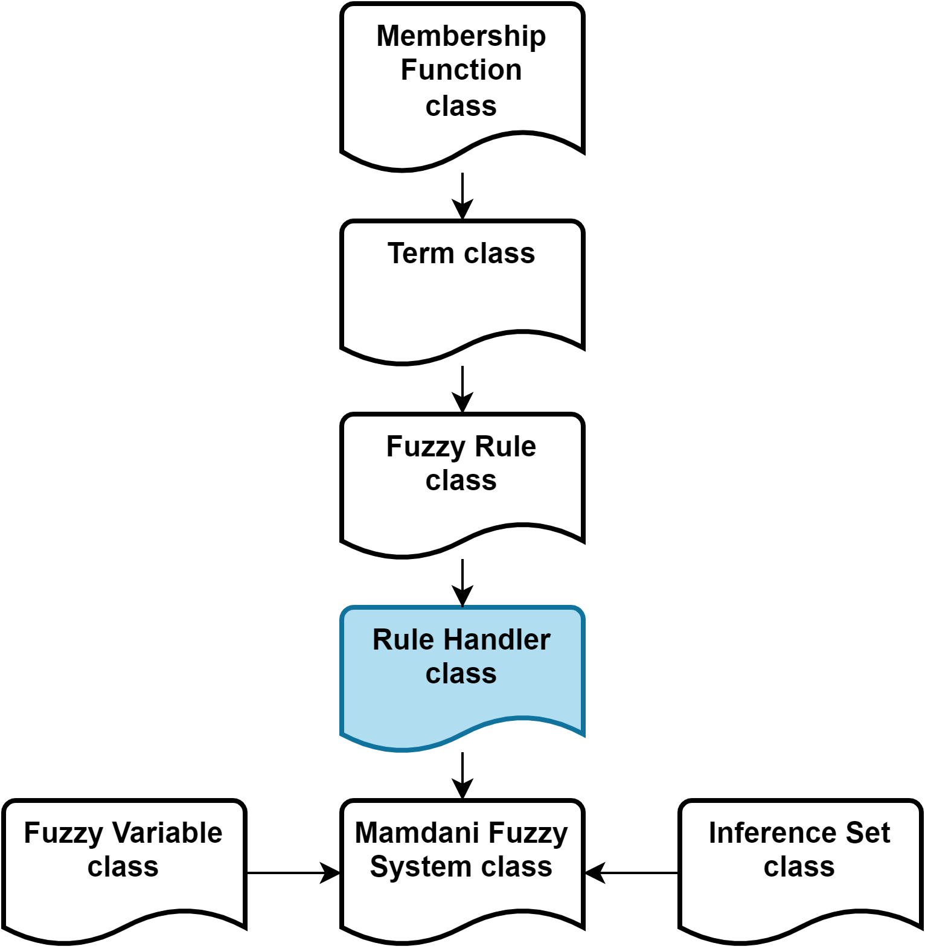
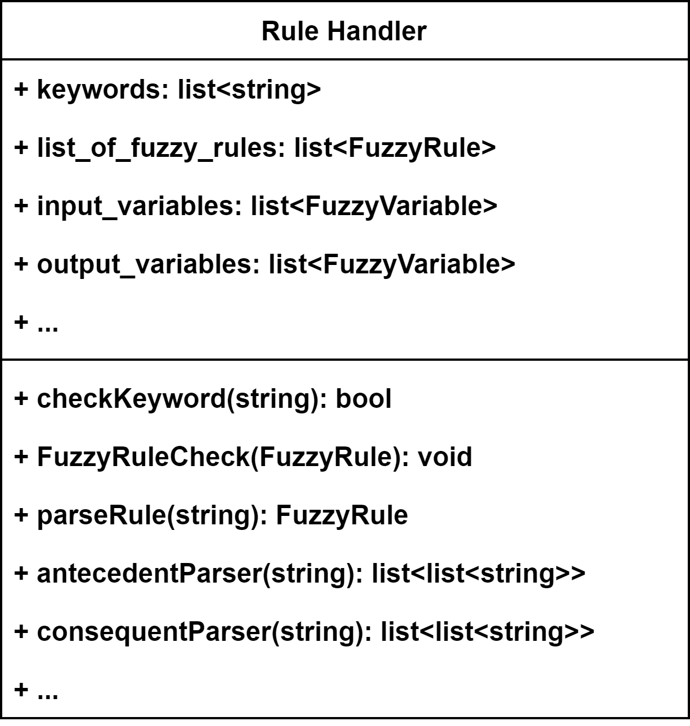
x. C++ FUZZY LOGIC LIBRARY
Fig. 1.1 Firmware architecture

Slide 28
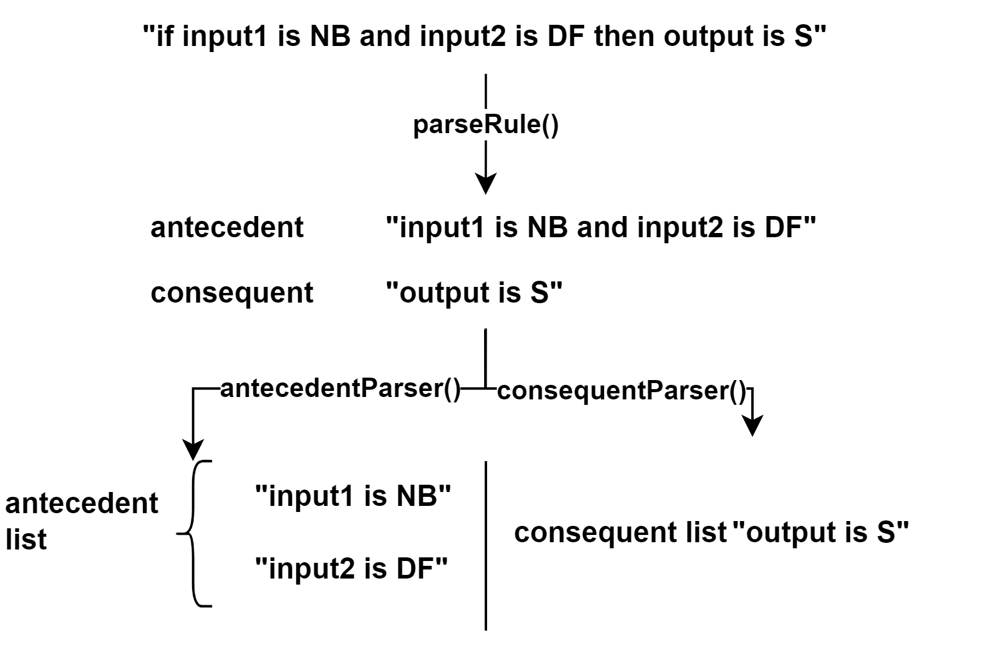
x. C++ FUZZY LOGIC LIBRARY
Fig. 1.1 Firmware architecture

Slide 29
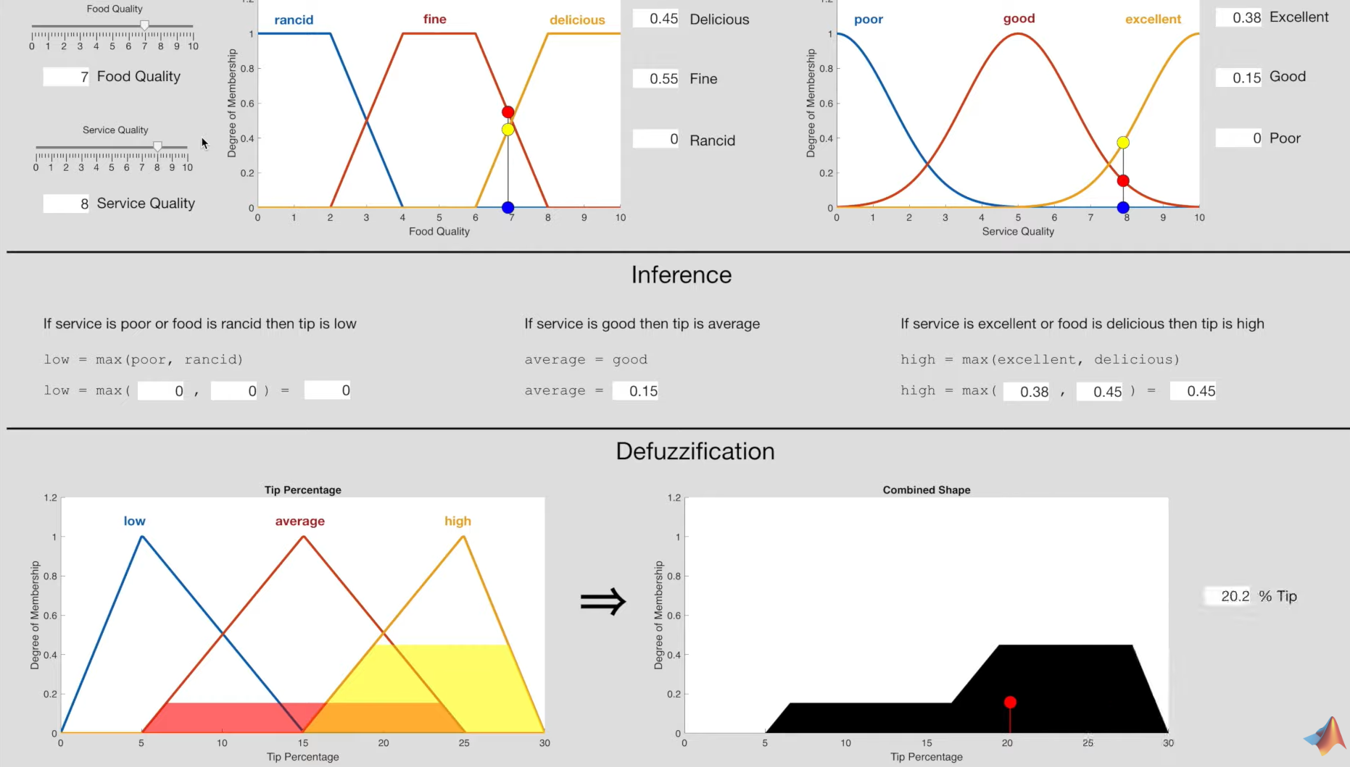
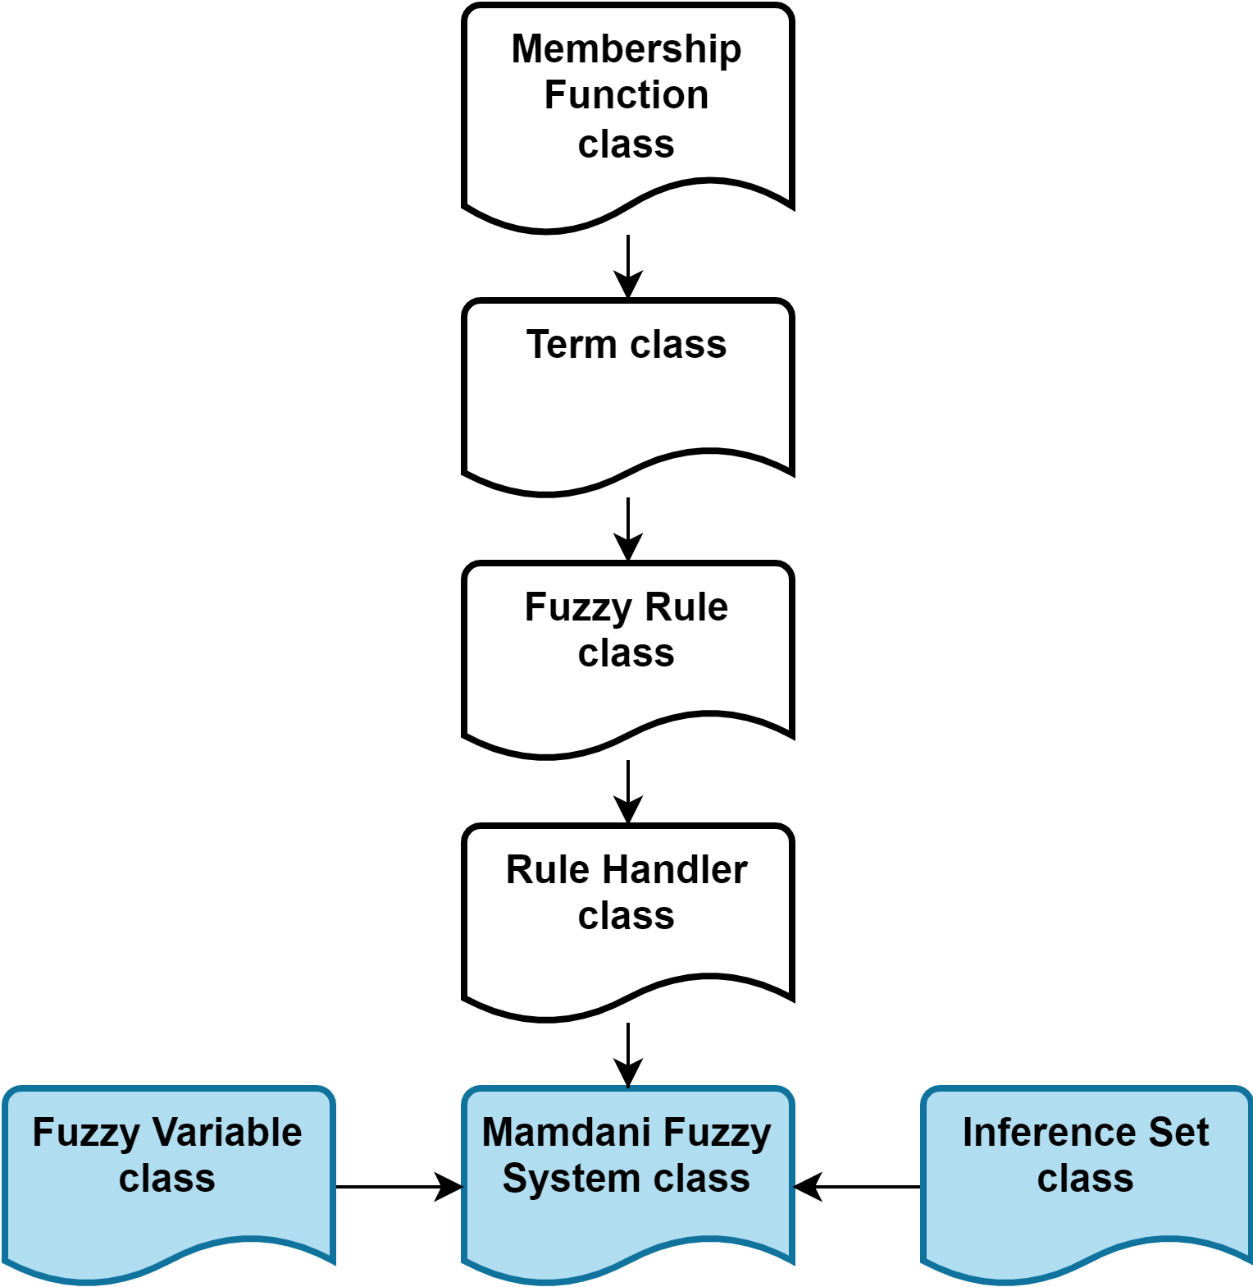
x. C++ FUZZY LOGIC LIBRARY
Fig. 1.1 Firmware architecture
Fig. 1.x Firmware architecture

Slide 30
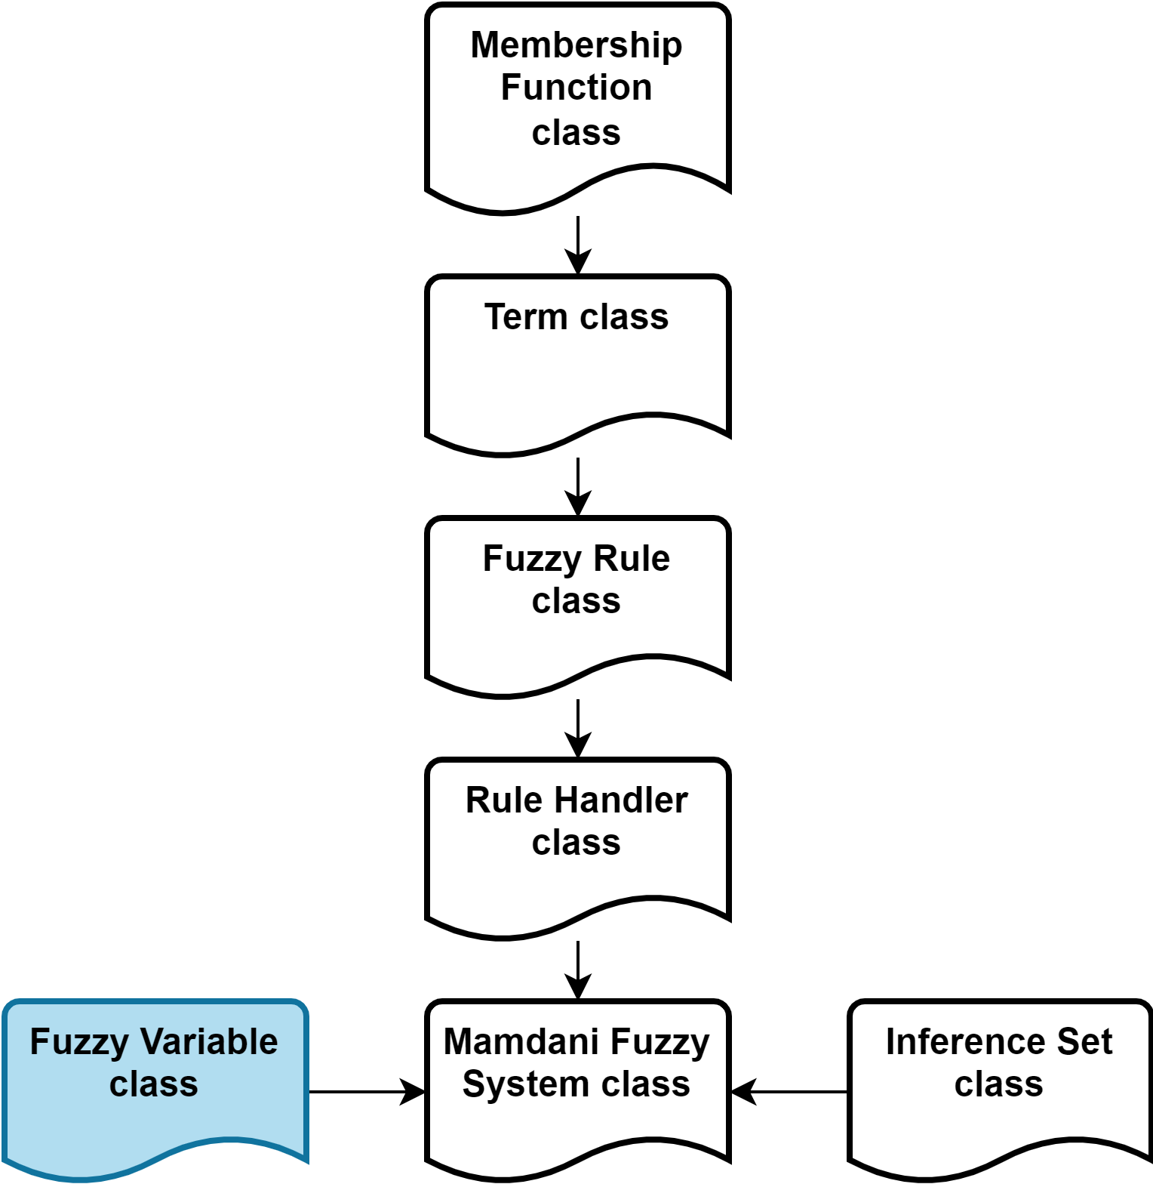
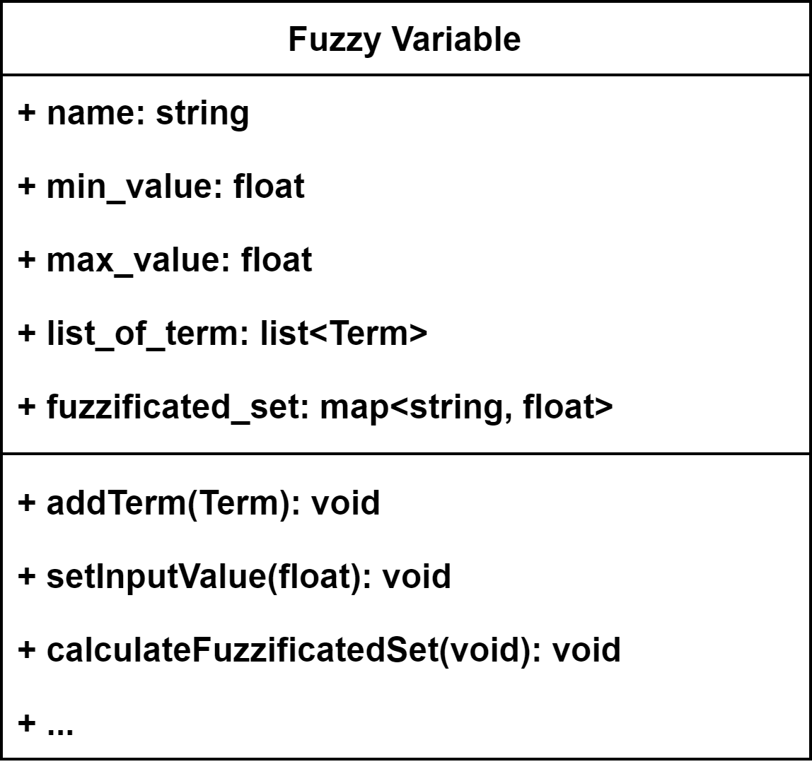
x. C++ FUZZY LOGIC LIBRARY
Fig. 1.1 Firmware architecture

Slide 31
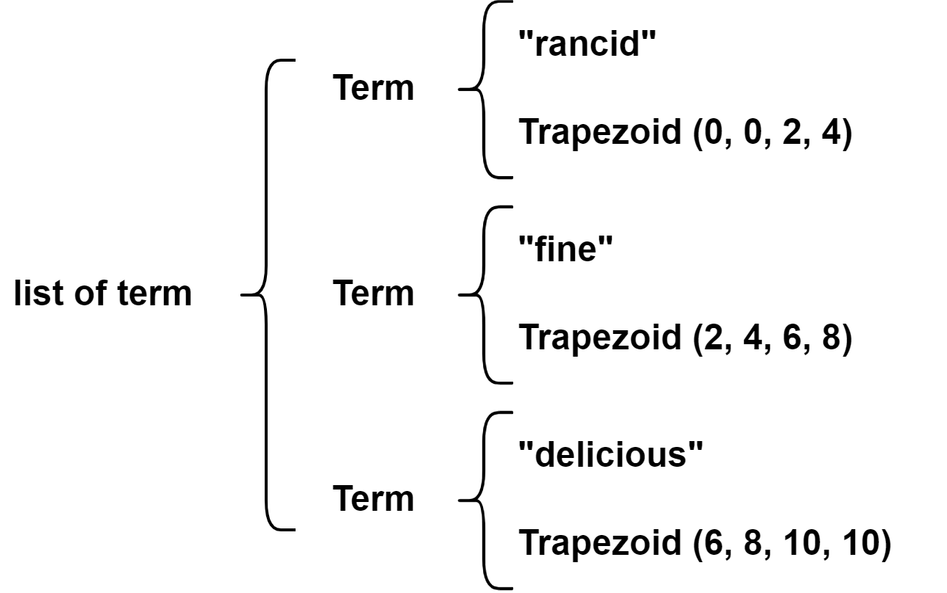
x. C++ FUZZY LOGIC LIBRARY
Fig. 1.1 Firmware architecture

Slide 32
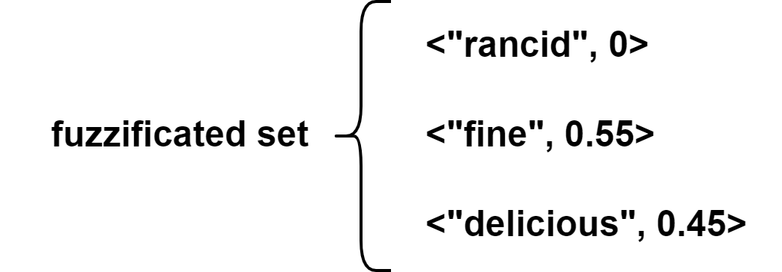
x. C++ FUZZY LOGIC LIBRARY
Fig. 1.1 Firmware architecture

Slide 33
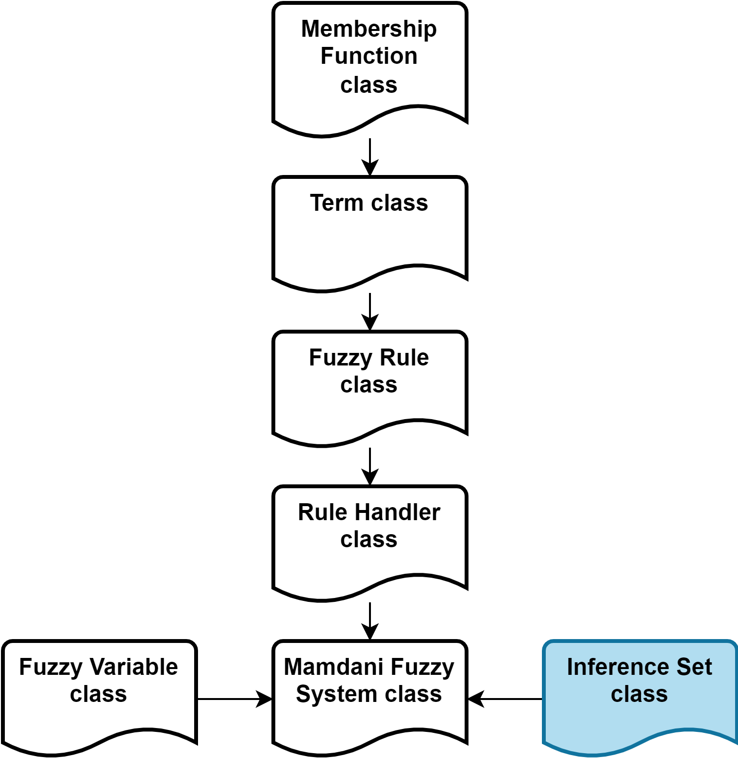

x. C++ FUZZY LOGIC LIBRARY
Fig. 1.1 Firmware architecture

Slide 34

x. C++ FUZZY LOGIC LIBRARY
Fig. 1.1 Firmware architecture

Slide 35




x. C++ FUZZY LOGIC LIBRARY
Fig. 1.1 Firmware architecture
Fig. 1.1 Firmware architecture
Fig. 1.1 Firmware architecture

Slide 36


x. C++ FUZZY LOGIC LIBRARY
Fig. 1.1 Firmware architecture
$$∫f\left(x\right)dx≈Σ_{i=1}^{n}f\left(x_{i}\right)$$
Fig. 1.1 Firmware architecture

Slide 37



x. C++ FUZZY LOGIC LIBRARY
Fig. 1.1 Firmware architecture
Fig. 1.1 Firmware architecture
$$x_{cen}=\frac{\int{x}∙f\left(x\right)dx}{\int{f}\left(x\right)dx}=\frac{Σ_{i=1}^{n}x_{i}.f\left(x_{i}\right)}{Σ_{i=1}^{n}f\left(x_{i}\right)}$$
Fig. 1.1 Firmware architecture

Slide 38



x. C++ FUZZY LOGIC LIBRARY
Fig. 1.1 Firmware architecture
Fig. 1.1 Firmware architecture
Fig. 1.1 Firmware architecture

Slide 39


x. C++ FUZZY LOGIC LIBRARY
Fig. 1.1 Firmware architecture
Fig. 1.1 Firmware architecture

Slide 40


1. INTRODUCTION
Matradee Robot
Phenikaa-X delivery Robot

Slide 41

2. DESIGN IDEA
Design purpose:
+ Robot can self-navigate to the desired goal and avoid obstacles.
+ Robot can interact with customer via screen and speaker.
Specification:
+ Sensor: LiDAR, Ultrasonic sensor, IMU
+ Navigation method: SLAM
+ Body weight: 7 kg
+ Maximum load weight: 15 kg
+ Speed: 0.5 m/s
+ Power: 54 W
2D design

Slide 42



2. DESIGN IDEA

Slide 43
THANK YOU !

